Slide 1
Correction for Electron “Protoemission“
Model, ideas, approaches, results

Slide 2
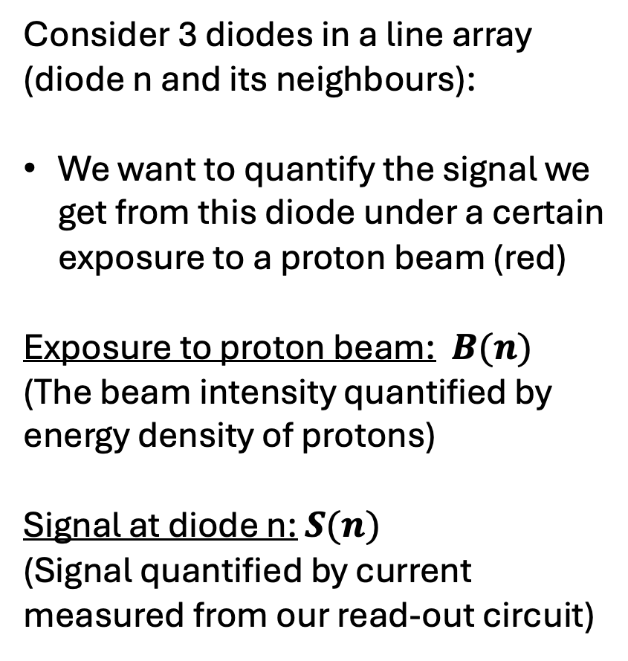
Model
Consider 3 diodes in a line array (diode n and its neighbours):
We want to quantify the signal we get from this diode under a certain exposure to a proton beam (red)
Exposure to proton beam: $B(n)$
(The beam intensity quantified by energy density of protons)
Signal at diode n: $S(n)$
(Signal quantified by current measured from our read-out circuit)
Diode n+1
Diode n
Diode n-1

Slide 3
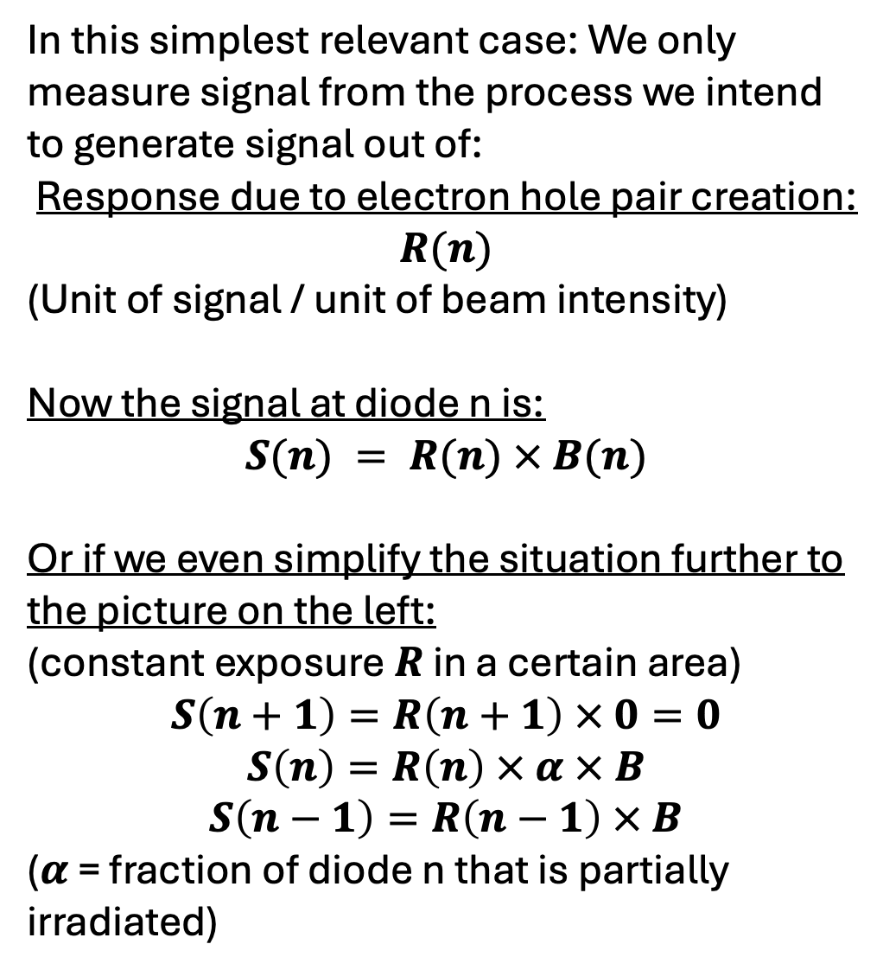
1. Naive case
In this simplest relevant case: We only measure signal from the process we intend to generate signal out of:
Response due to electron hole pair creation: $R(n)$
(Unit of signal / unit of beam intensity)
Now the signal at diode n is:
$$S(n) = R(n) × B(n)$$
Or if we even simplify the situation further to the picture on the left:
(constant exposure $R$ in a certain area)
$$S\left(n+1\right)=R\left(n+1\right) × 0=0$$
$$S\left(n\right)=R\left(n\right) × α × B$$
$$S\left(n−1\right)=R\left(n−1\right) × B$$
($α$ = fraction of diode n that is partially irradiated)
Diode n+1
Diode n
Diode n-1

Slide 4
This case is not what we observe though!
red = beam on
real shape
what we should see
what we see

Slide 5
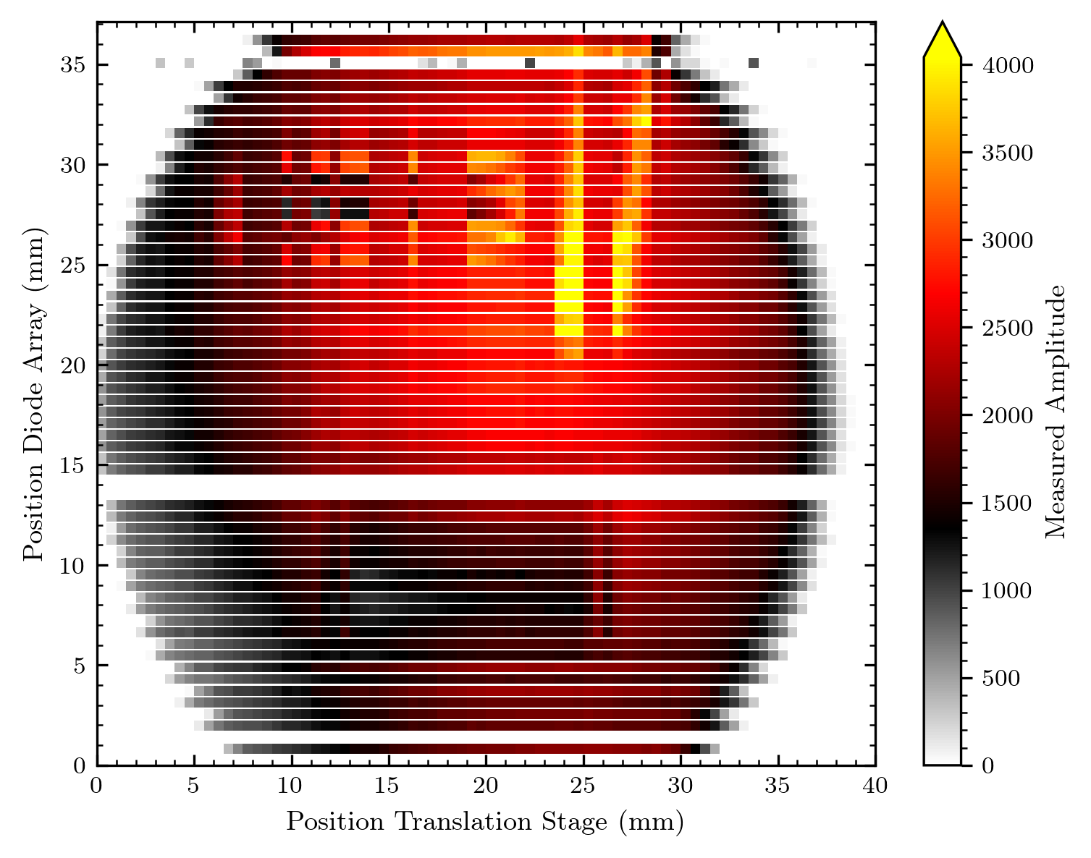
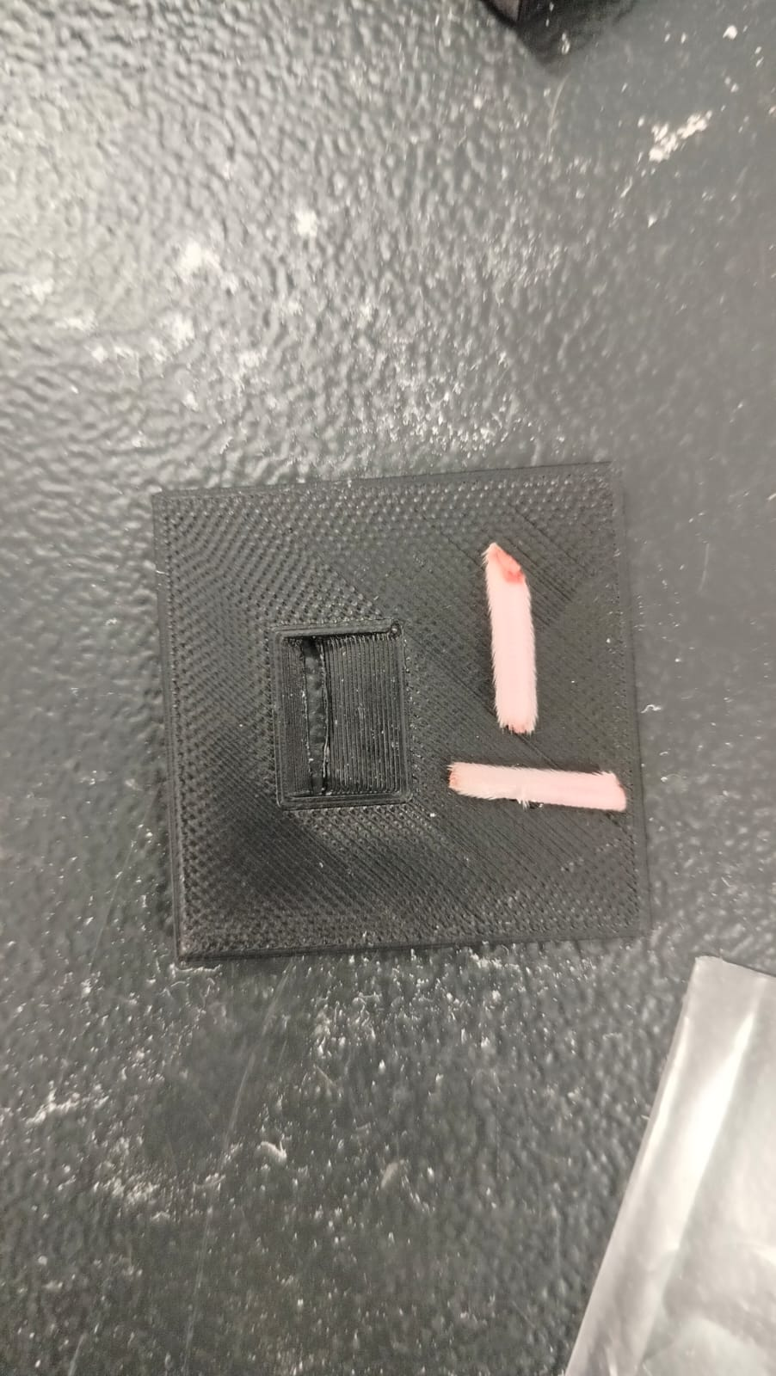
Example
But we do not see this step-like sampled shape of the round aperture
We observe a periodic modulation of shorter and longer lines…
longer
shorter
Object
round opening of
proton beam

Slide 6
2. Considering electron “protoemission“
Protons deposit energy in the GaN diode, especially in the i-GaN layer, where we detect this energy as a current from separated electron hole pairs.
But the protons also lose energy while passing through layers on top of the diode – for example the metal contacts.
Energy deposited here will mainly excite electrons, which can leave the metal when overcoming the necessary work function.
Electrons that leave the metal are a loss in our signal because we detect an electron current.

Slide 7
2. Some questions about this “protoemission“
Have I summarized the process correctly?
What is the exact transfer process for the electrons? (e.g. are they moved through air? Would a change of medium around the diode array change the transfer efficiency?)
Do we consider only the metal parts, probably mainly the MESA and/or the fan-out wiring to be responsible?
Are all electrons captured and detected by neighbour diodes?
Can we quantify this protoemission by measurements (and/or simulations) to have a proof for our model?

Slide 8
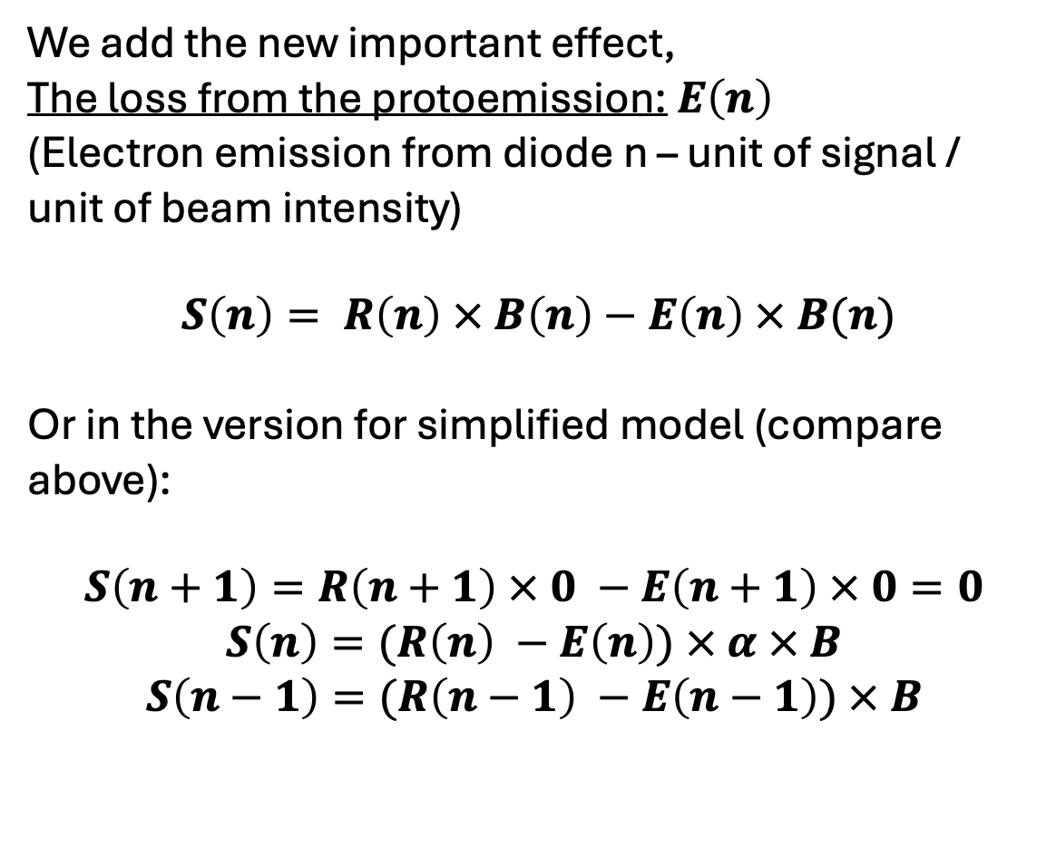
2. Model for protoemission
We add the new important effect,
The loss from the protoemission: $E\left(n\right)$
(Electron emission from diode n – unit of signal / unit of beam intensity)
$S\left(n\right)= R\left(n\right) × B\left(n\right)−E\left(n\right) × B(n)$
Or in the version for simplified model (compare above):
$$S\left(n+1\right)=R\left(n+1\right) × 0 −E\left(n+1\right) × 0=0$$
$$S\left(n\right)=(R\left(n\right) −E\left(n\right)) × α × B$$
$$S\left(n−1\right)=(R\left(n−1\right) −E\left(n−1\right)) × B$$

Slide 9
So far this is just the case from above with a signal decrease!

Slide 10
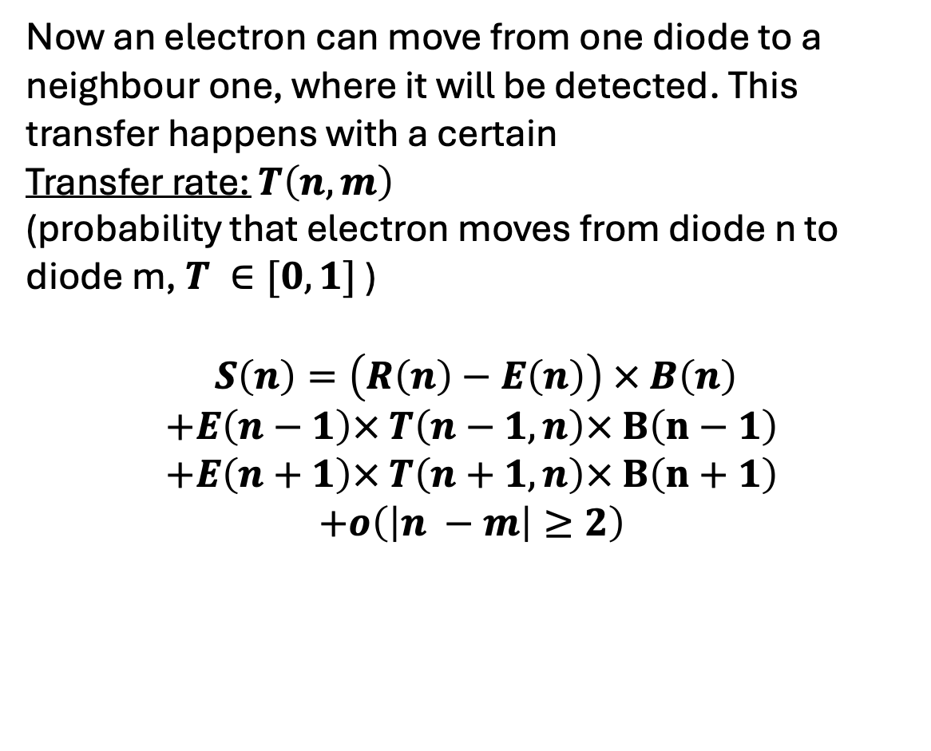
3. Consider electron transfer between diodes
Now an electron can move from one diode to a neighbour one, where it will be detected. This transfer happens with a certain
Transfer rate: $T\left(n, m\right)$
(probability that electron moves from diode n to diode m, $T ∈[0, 1]$ )
$S\left(n\right)=\left(R\left(n\right)−E\left(n\right)\right) × B\left(n\right)$
$$+E\left(n−1\right)× T\left(n−1, n\right)× B\left(n−1\right)$$
$$+E\left(n+1\right)× T\left(n+1, n\right)× B\left(n+1\right)$$
$$+o\left(\left|n −m\right|≥2\right)$$

Slide 11
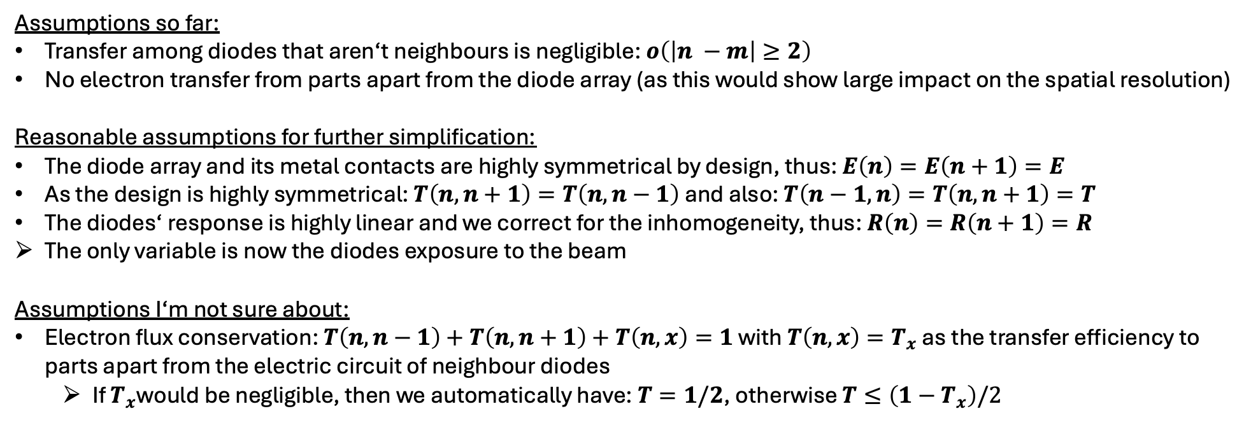
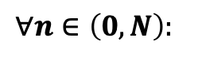
Final equation and assumptions
We look at a 1D diode array of length N, with 0 naming the first and N the last diode, then we model the signal by:
$$∀n∈\left(0, N\right):$$
$$S\left(n\right)=\left(R\left(n\right)−E\left(n\right)\right) × B\left(n\right)+E\left(n−1\right)× T\left(n−1, n\right)× B\left(n−1\right)+E\left(n+1\right)× T\left(n+1, n\right)× B\left(n+1\right)$$
e⁻-h⁺ creation
e⁻ received from neighbour diodes
(to ease the understanding we denote: n-1 below diode n, n+1 above)
proto-emission at diode n
Assumptions so far:
Transfer among diodes that aren‘t neighbours is negligible: $o\left(\left|n −m\right|≥2\right)$
No electron transfer from parts apart from the diode array (as this would show large impact on the spatial resolution)
Reasonable assumptions for further simplification:
The diode array and its metal contacts are highly symmetrical by design, thus: $E\left(n\right)=E\left(n+1\right)=E$
As the design is highly symmetrical: $T\left(n, n+1\right)=T\left(n, n−1\right)$ and also: $T\left(n−1, n\right)=T\left(n, n+1\right)=T$
The diodes‘ response is highly linear and we correct for the inhomogeneity, thus: $R\left(n\right)=R\left(n+1\right)=R$
The only variable is now the diodes exposure to the beam
Assumptions I‘m not sure about:
Electron flux conservation: $T\left(n, n−1\right)+T\left(n, n+1\right)+T\left(n, x\right)=1$ with $T\left(n, x\right)=T_{x}$ as the transfer efficiency to parts apart from the electric circuit of neighbour diodes
If $T_{x}$would be negligible, then we automatically have: $T=1/2$, otherwise $T≤\left(1−T_{x}\right)/2$

Slide 12
Apply model to situation of uniform beam
This was not 100% the case in the measurements (compare y-shift of diode array) but is reasonable enough and/or can be corrected because we have info about the y-characteristics of the beam

Slide 13
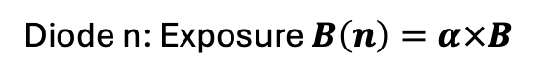
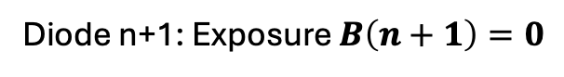
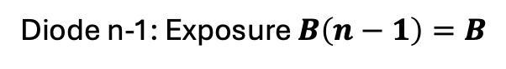
What the uniform beam changes
Red region, proton beam, equals exposure $B=const.$
Diode n+1: Exposure $B\left(n+1\right)=0$
Diode n: Exposure $B\left(n\right)=α×B$
Diode n-1: Exposure $B\left(n−1\right)=B$

Slide 14
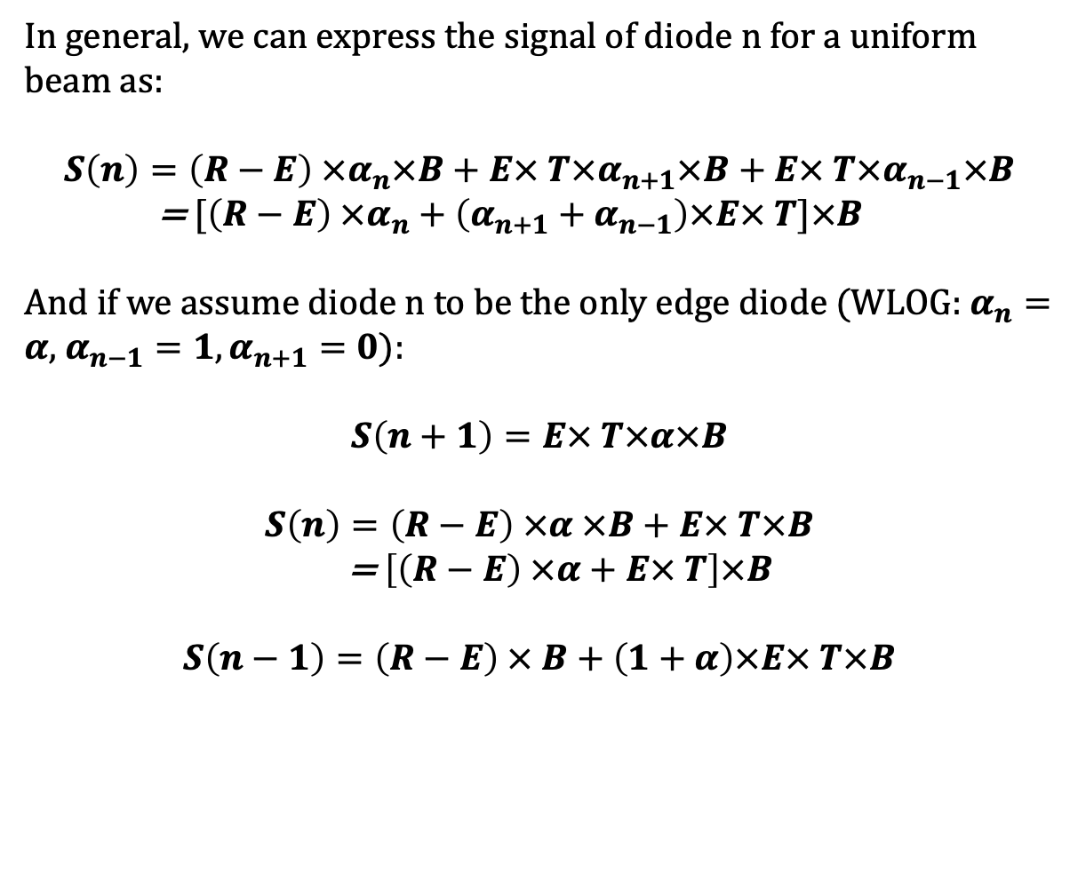
The equation in the uniform beam situation
In general, we can express the signal of diode n for a uniform beam as:
$$S\left(n\right)=\left(R−E\right) ×α_{n}×B+E× T×α_{n+1}×B+E× T×α_{n−1}×B$$
= $[\left(R−E\right) ×α_{n}+\left(α_{n+1}+α_{n−1}\right)×E× T]×B$
And if we assume diode n to be the only edge diode (WLOG: $α_{n}=α$, $α_{n−1}=1,α_{n+1}=0$):
$$S\left(n+1\right)=E× T×α×B$$
$$S\left(n\right)=\left(R−E\right) ×α ×B+E× T×B$$
= $\left[\left(R−E\right) ×α+E× T\right]×B$
$$S\left(n−1\right)=\left(R−E\right) × B+\left(1+α\right)×E× T×B$$
Diode n+1
Diode n
Diode n-1

Slide 15
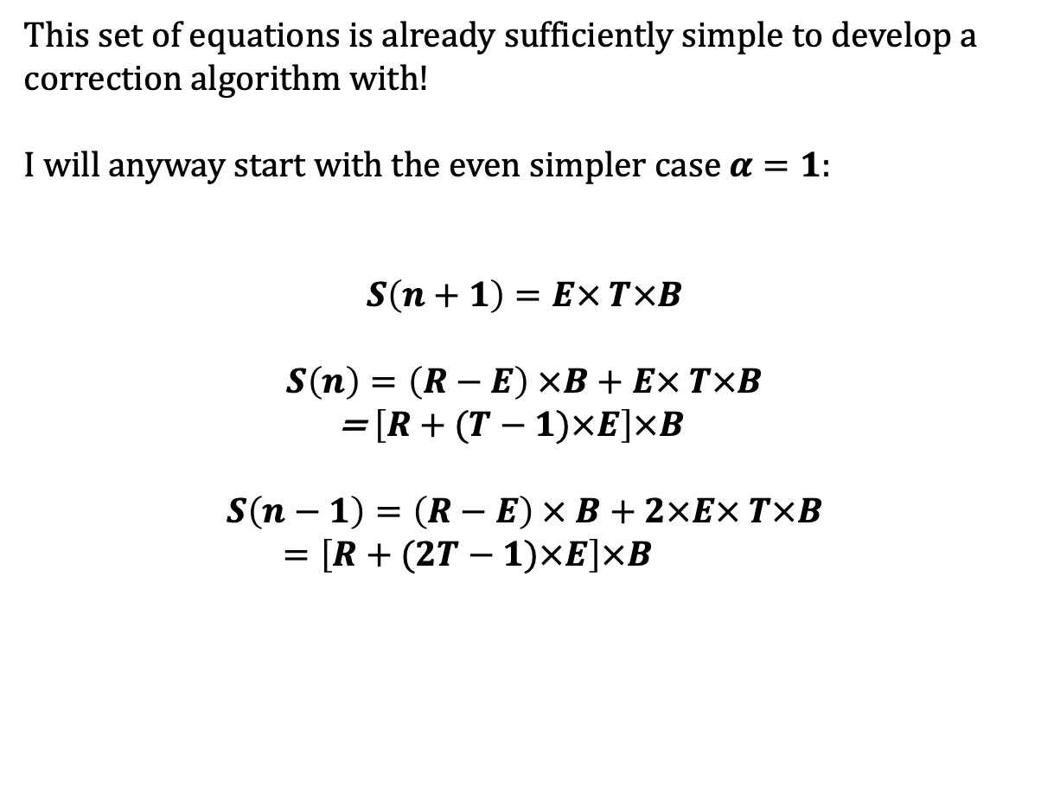
The equation in the uniform beam situation
This set of equations is already sufficiently simple to develop a correction algorithm with!
I will anyway start with the even simpler case $α=1$:
$$S\left(n+1\right)=E× T×B$$
$$S\left(n\right)=\left(R−E\right) ×B+E× T×B$$
= $\left[R+(T−1)×E\right]×B$
$$S\left(n−1\right)=\left(R−E\right) × B+2×E× T×B$$
$=\left[R+(2T−1)×E\right]×B$
Diode n+1
Diode n
Diode n-1

Slide 16
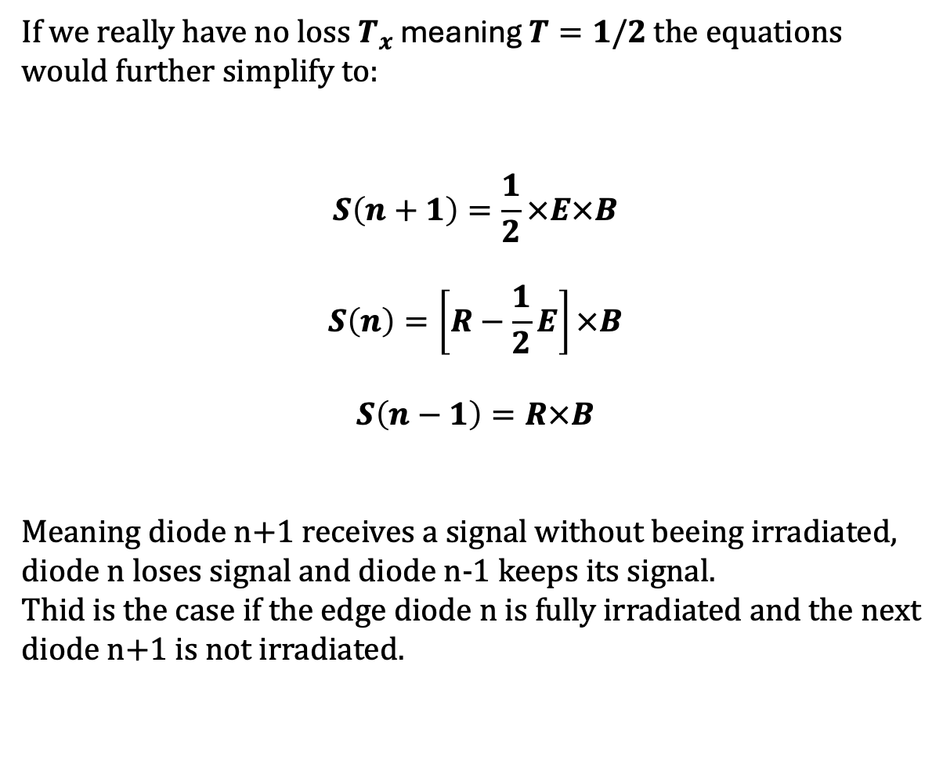
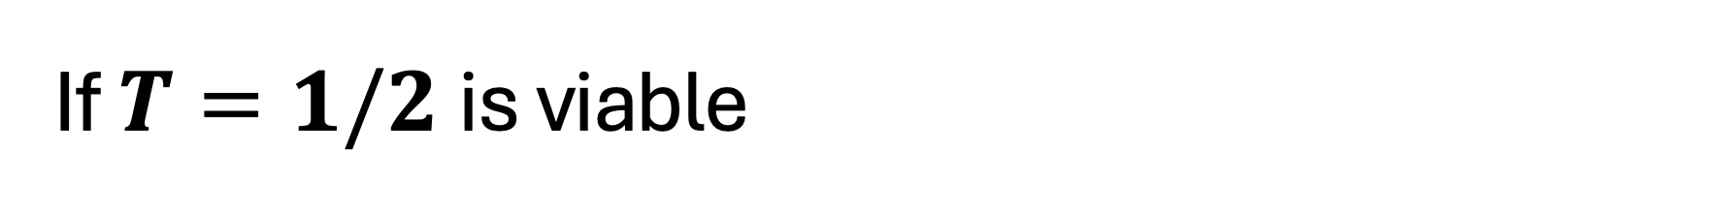
If $T=1/2$is viable
If we really have no loss $T_{x}$ meaning $T=1/2$ the equations would further simplify to:
$$S\left(n+1\right)=\frac{1}{2}×E×B$$
$$S\left(n\right)=\left[R−\frac{1}{2}E\right]×B$$
$$S\left(n−1\right)=R×B$$
Meaning diode n+1 receives a signal without beeing irradiated, diode n loses signal and diode n-1 keeps its signal.
Thid is the case if the edge diode n is fully irradiated and the next diode n+1 is not irradiated.
Diode n+1
Diode n
Diode n-1

Slide 17
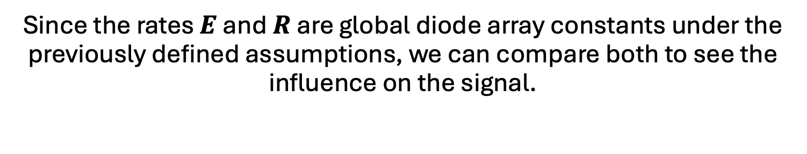
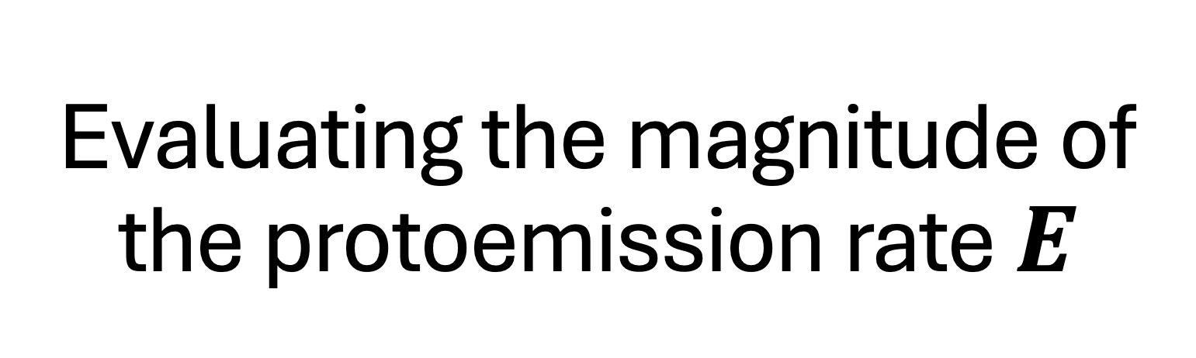
Evaluating the magnitude of the protoemission rate $E$
Since the rates $E$ and $R$ are global diode array constants under the previously defined assumptions, we can compare both to see the influence on the signal.

Slide 18
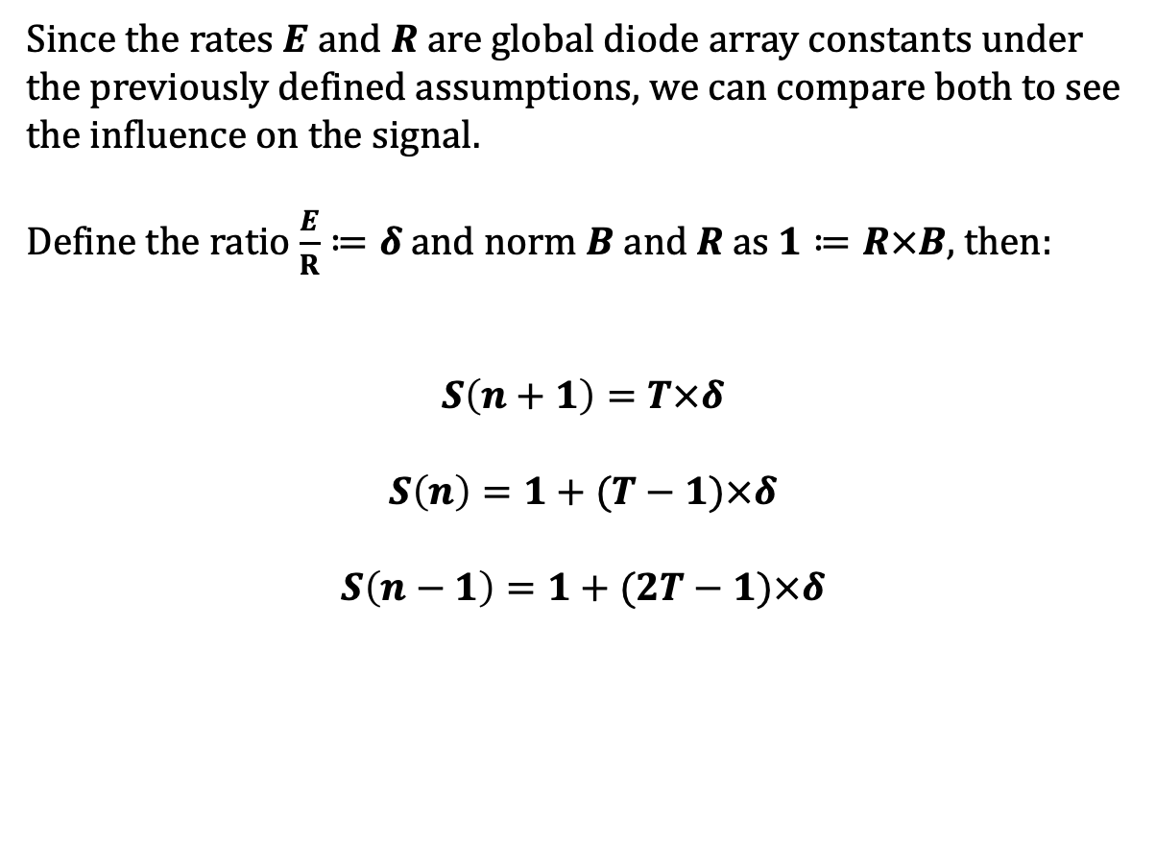
Starting with uniform beam equations
Since the rates $E$ and $R$ are global diode array constants under the previously defined assumptions, we can compare both to see the influence on the signal.
Define the ratio $\frac{E}{R}≔δ$and norm $B$ a$nd R$ as $1≔R×B$, then:
$$S\left(n+1\right)=T×δ$$
$$S\left(n\right)=1+(T−1)×δ$$
$$S\left(n−1\right)=1+(2T−1)×δ$$
Diode n+1
Diode n
Diode n-1

Slide 19
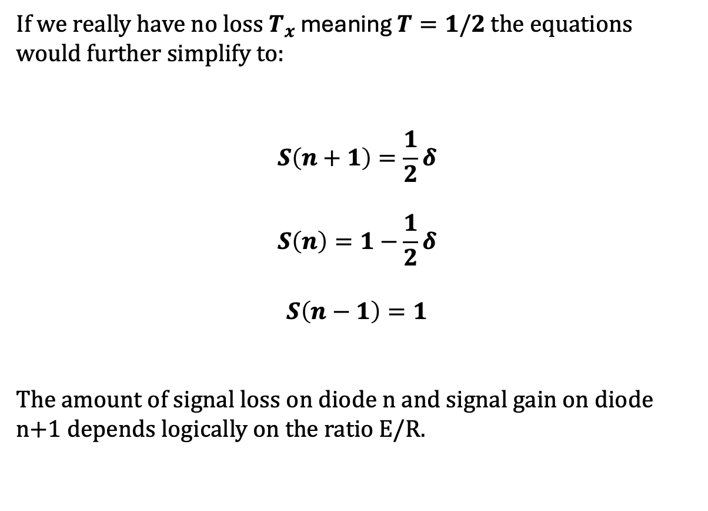
If $T=1/2$is viable
If we really have no loss $T_{x}$ meaning $T=1/2$ the equations would further simplify to:
$$S\left(n+1\right)=\frac{1}{2}δ$$
$$S\left(n\right)=1−\frac{1}{2}δ$$
$$S\left(n−1\right)=1$$
The amount of signal loss on diode n and signal gain on diode n+1 depends logically on the ratio E/R.
Diode n+1
Diode n
Diode n-1

Slide 21
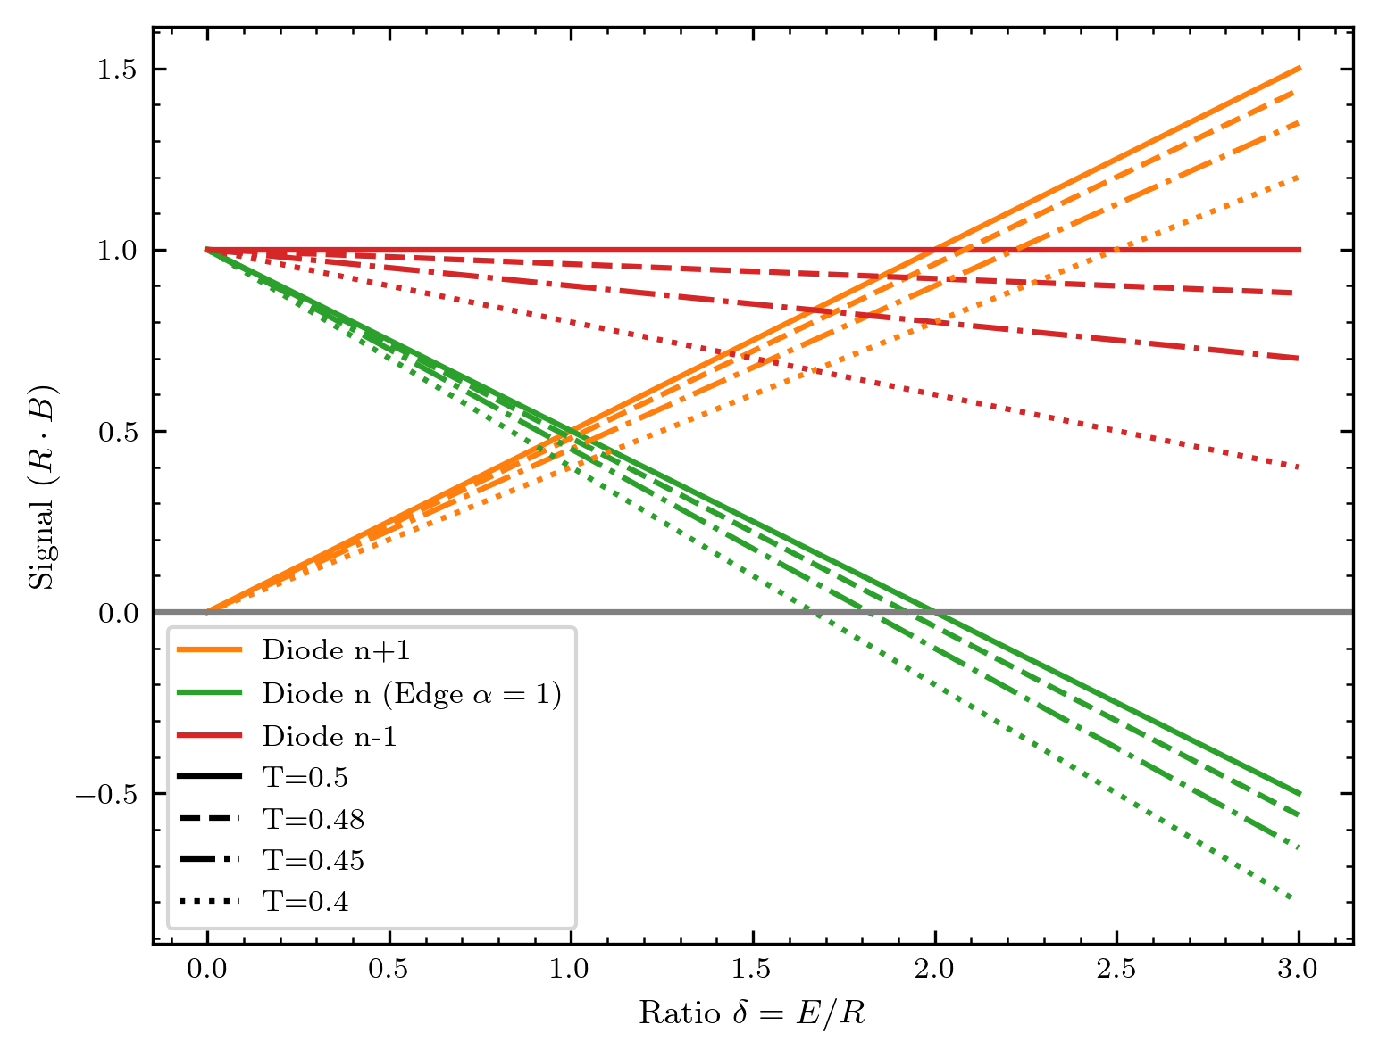

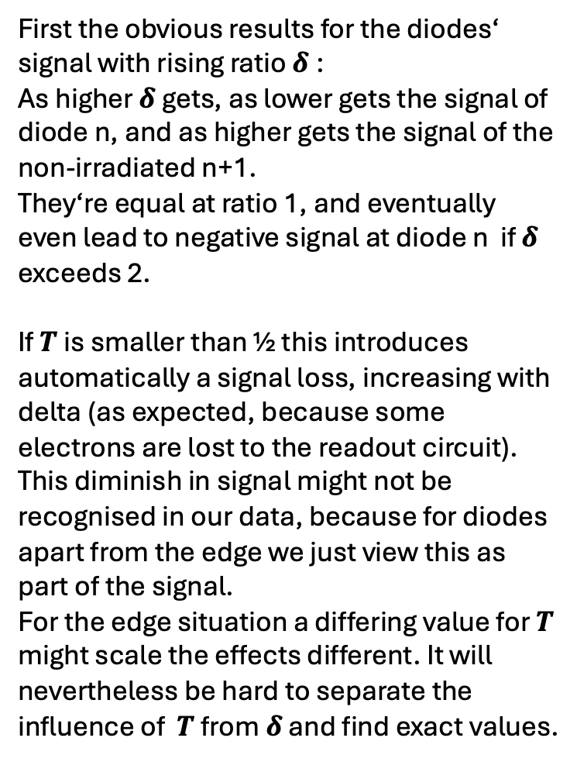
Some thoughts on $T≤$1/2
First the obvious results for the diodes‘ signal with rising ratio $δ$:
As higher $δ$ gets, as lower gets the signal of diode n, and as higher gets the signal of the non-irradiated n+1.
They‘re equal at ratio 1, and eventually even lead to negative signal at diode n if $δ$ exceeds 2.
If $T$ is smaller than ½ this introduces automatically a signal loss, increasing with delta (as expected, because some electrons are lost to the readout circuit).
This diminish in signal might not be recognised in our data, because for diodes apart from the edge we just view this as part of the signal.
For the edge situation a differing value for $T$ might scale the effects different. It will nevertheless be hard to separate the influence of $T$ from $δ$ and find exact values.

Slide 22
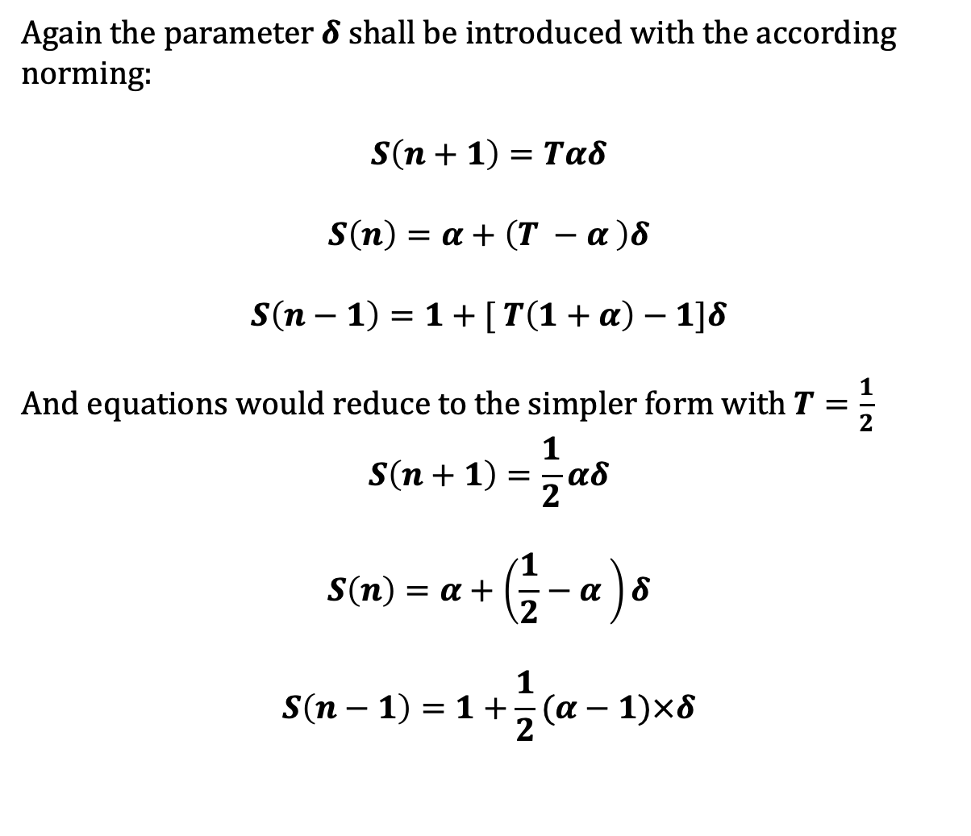

We add the complexity of edge covering $α$
Again the parameter $δ$ shall be introduced with the according norming:
$$S\left(n+1\right)=Tαδ$$
$$S\left(n\right)=α+\left(T −α \right)δ$$
$$S\left(n−1\right)=1+[ T\left(1+α\right)−1]δ$$
And equations would reduce to the simpler form with $T=\frac{1}{2}$
$$S\left(n+1\right)=\frac{1}{2}αδ$$
$$S\left(n\right)=α+\left(\frac{1}{2}−α \right)δ$$
$$S\left(n−1\right)=1+\frac{1}{2}(α−1)×δ$$
Diode n+1
Diode n
Diode n-1

Slide 23
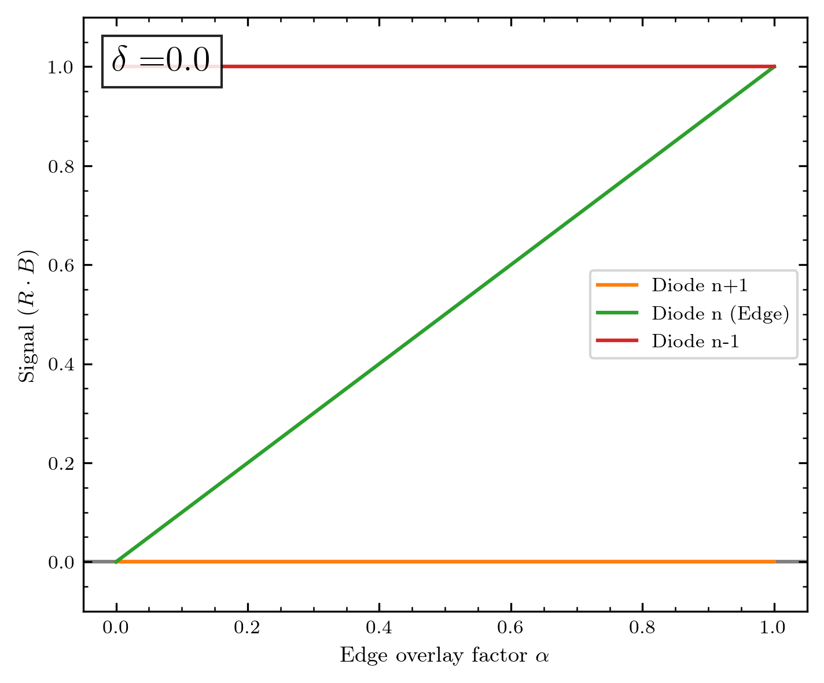
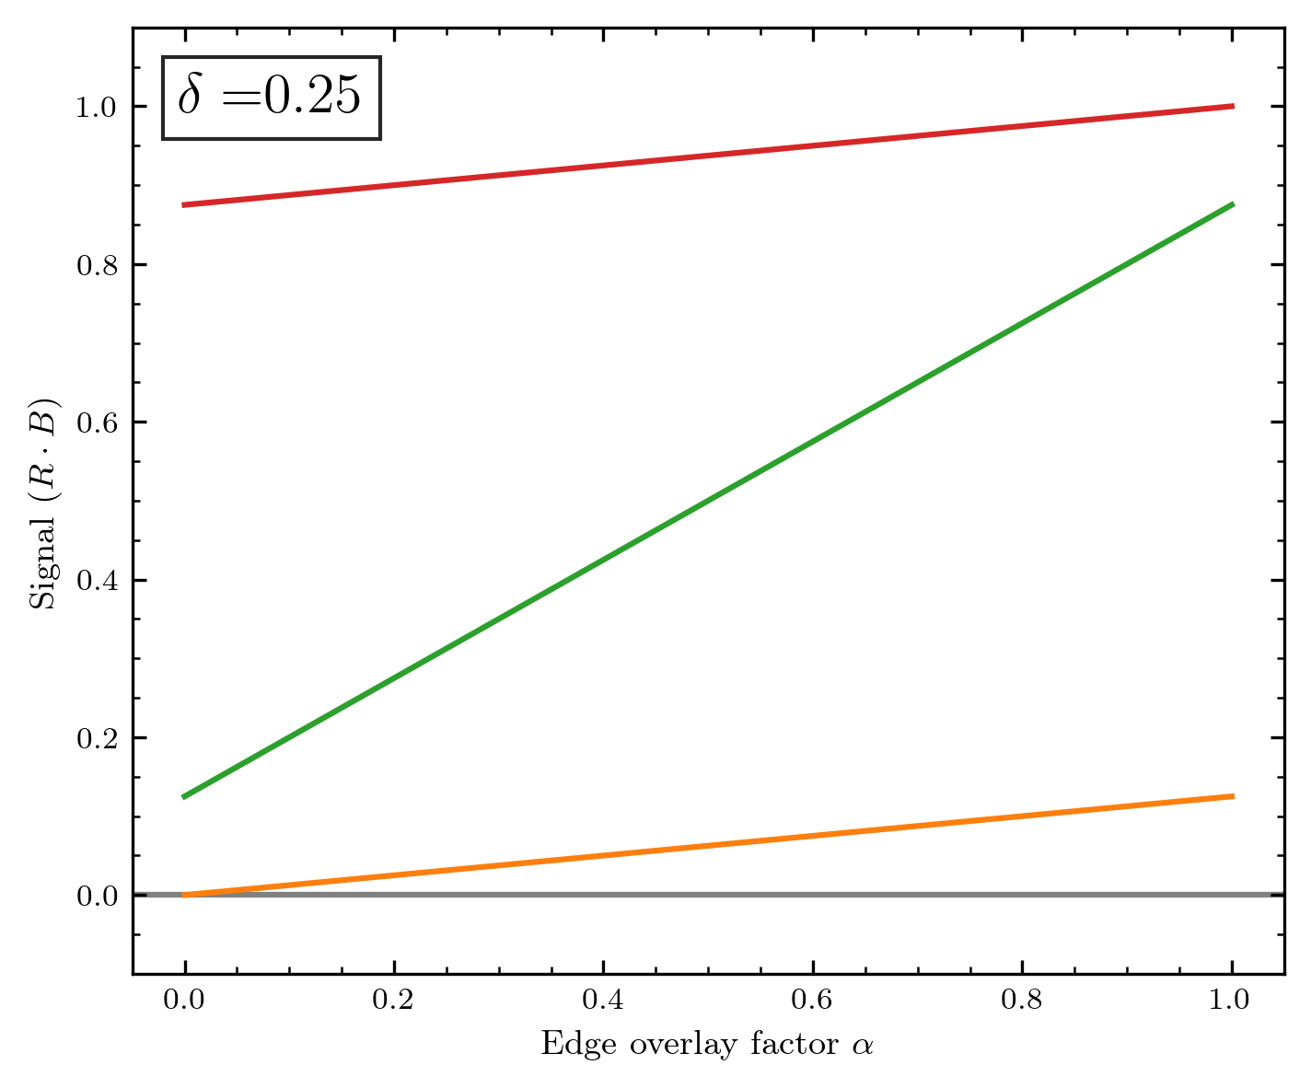
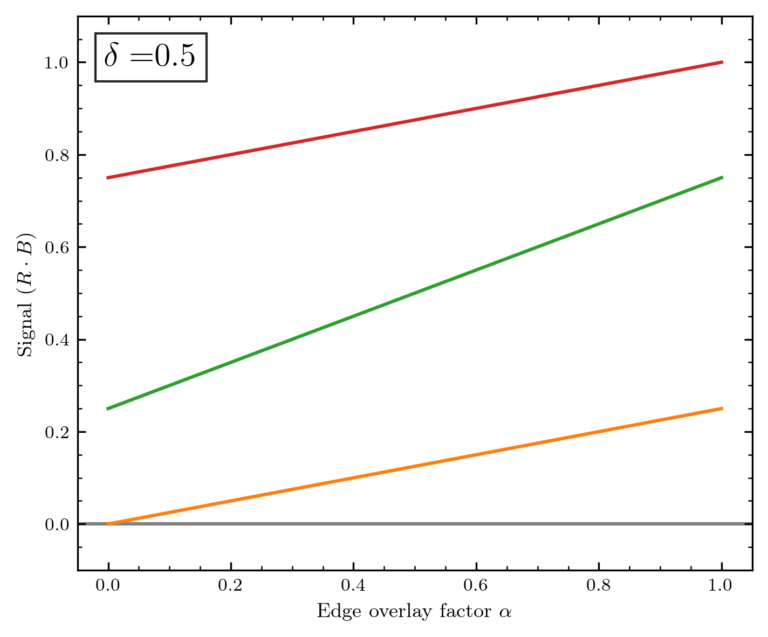
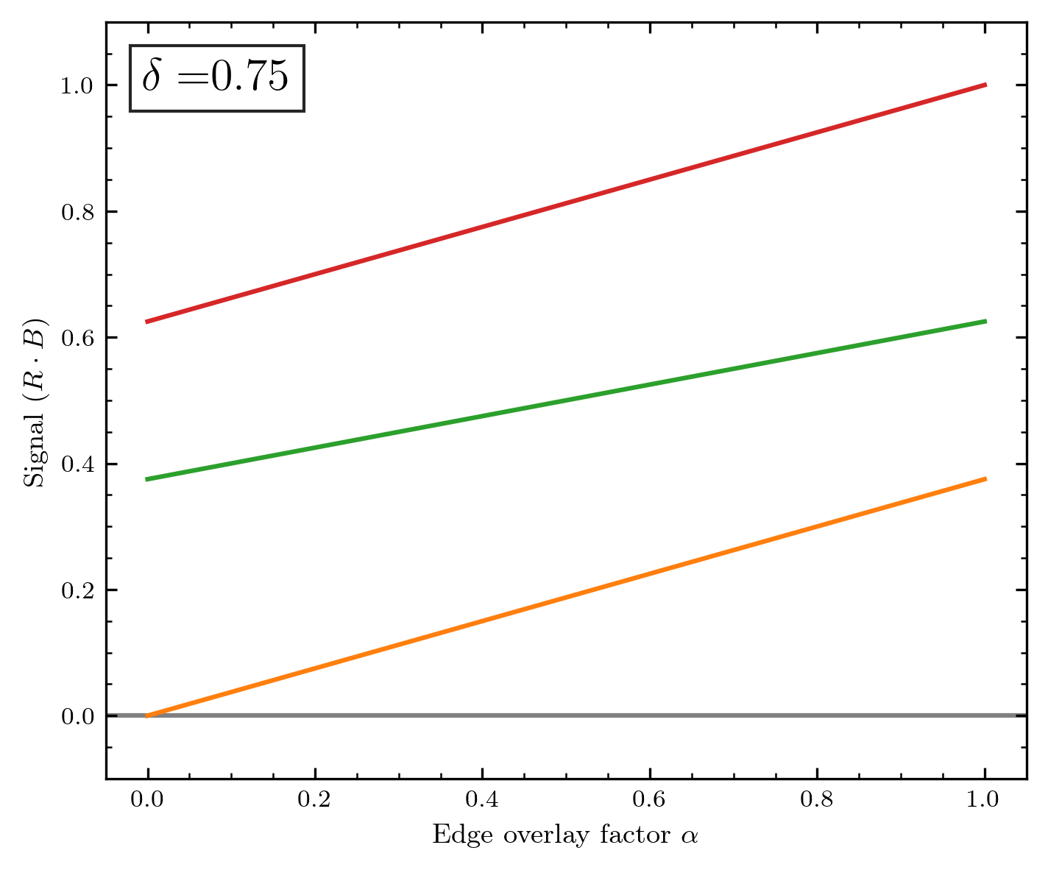
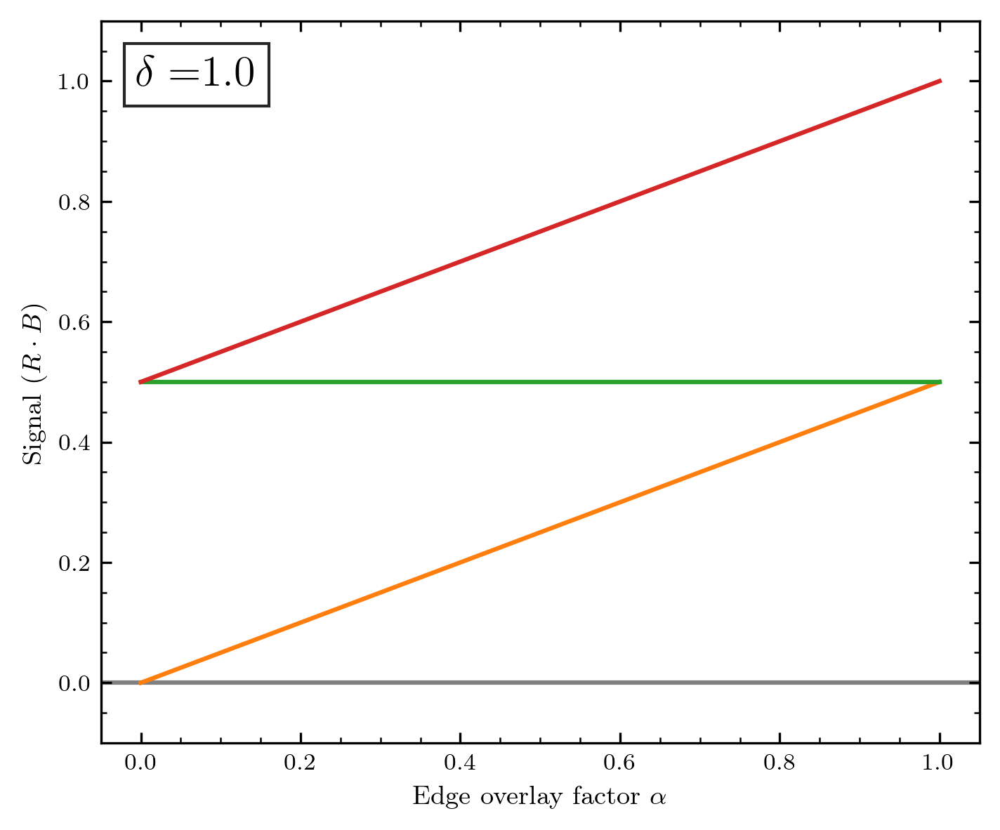
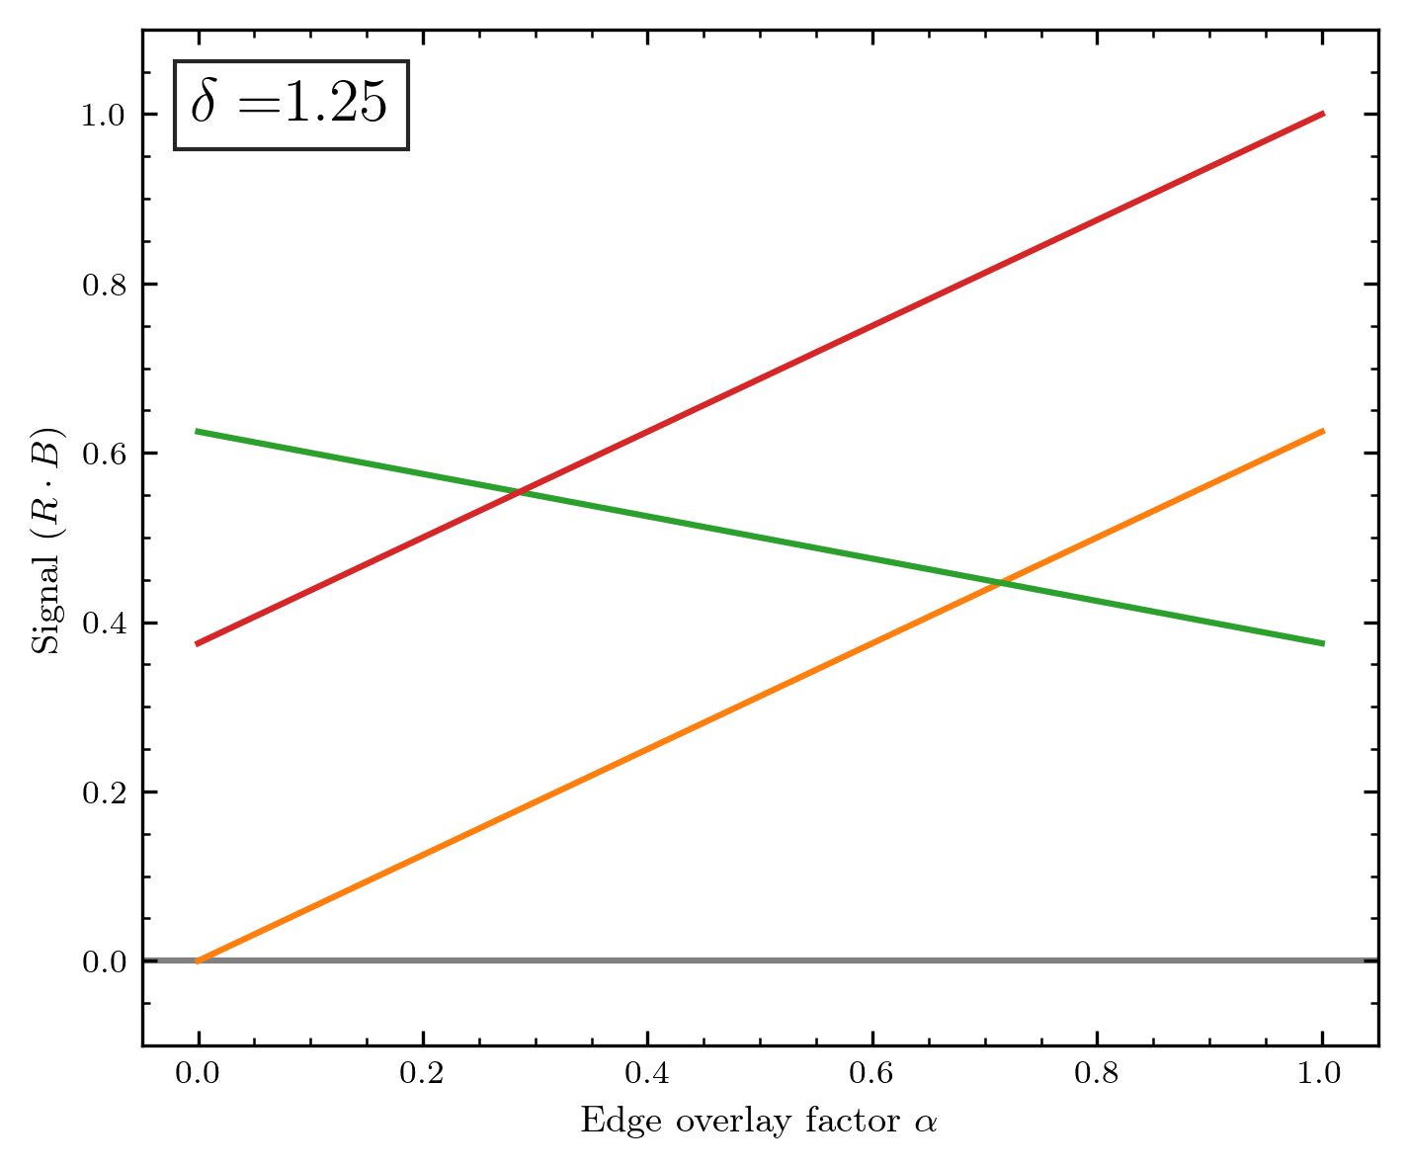

Slide 24
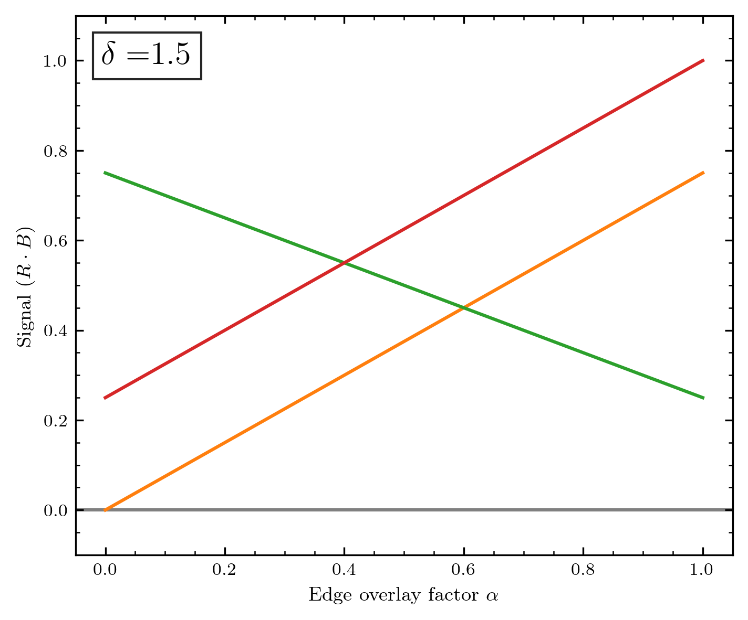
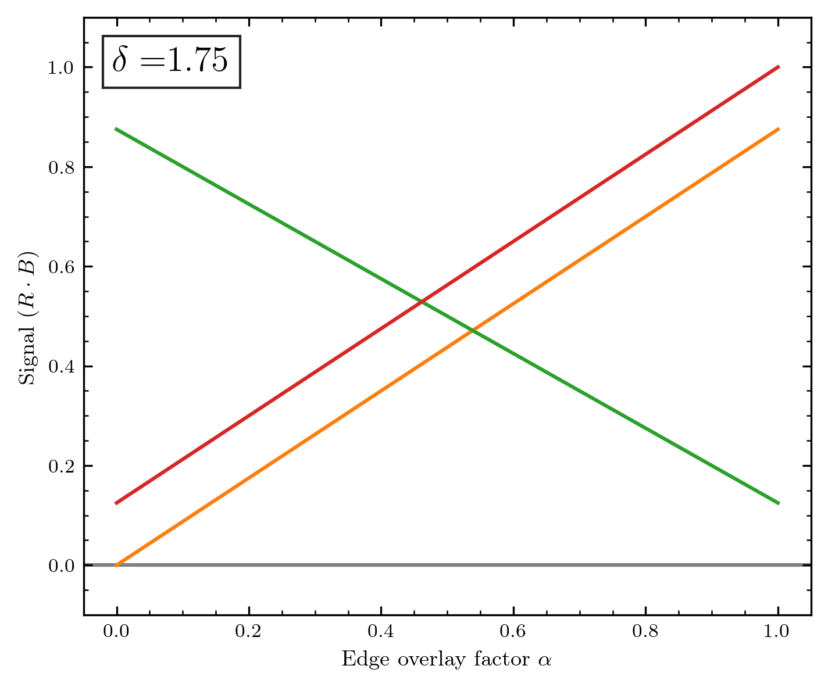
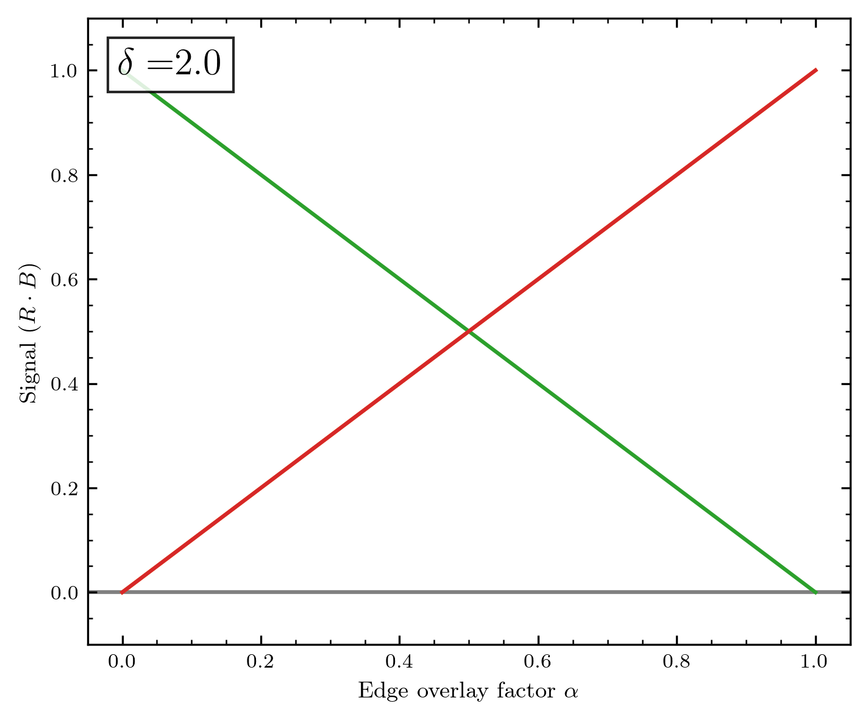
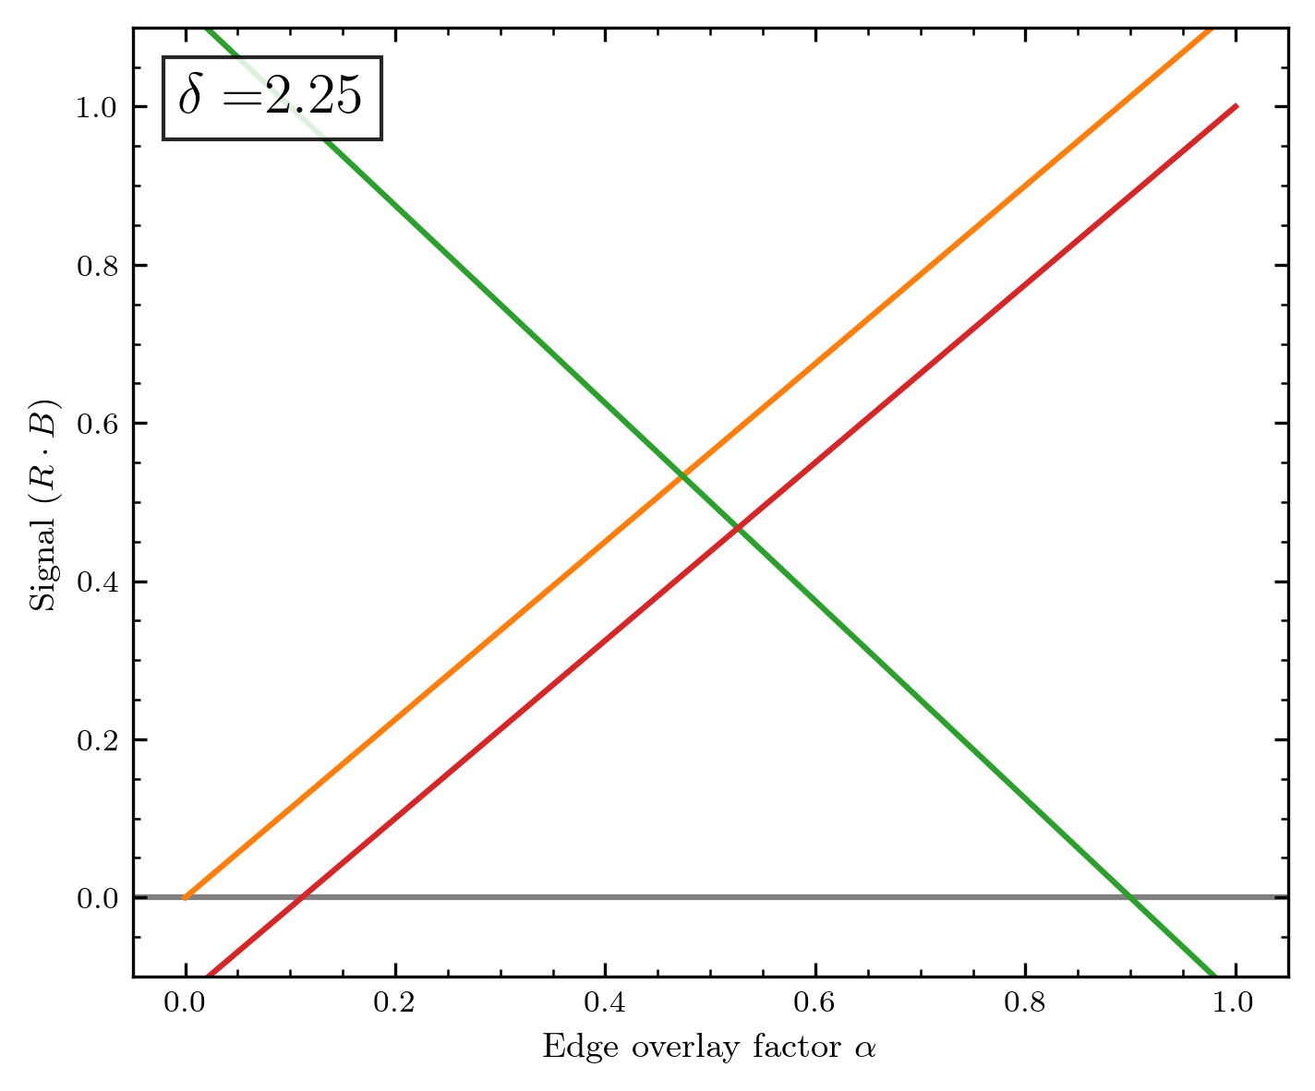
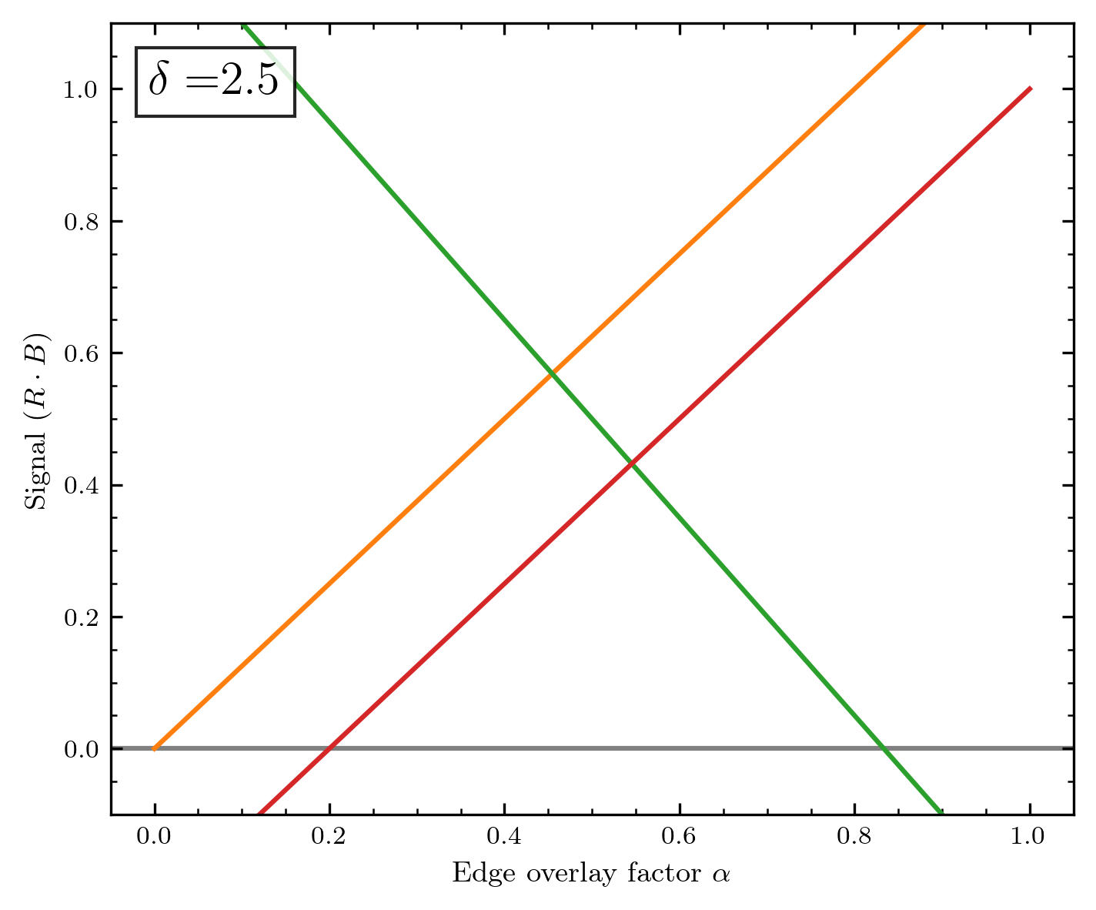
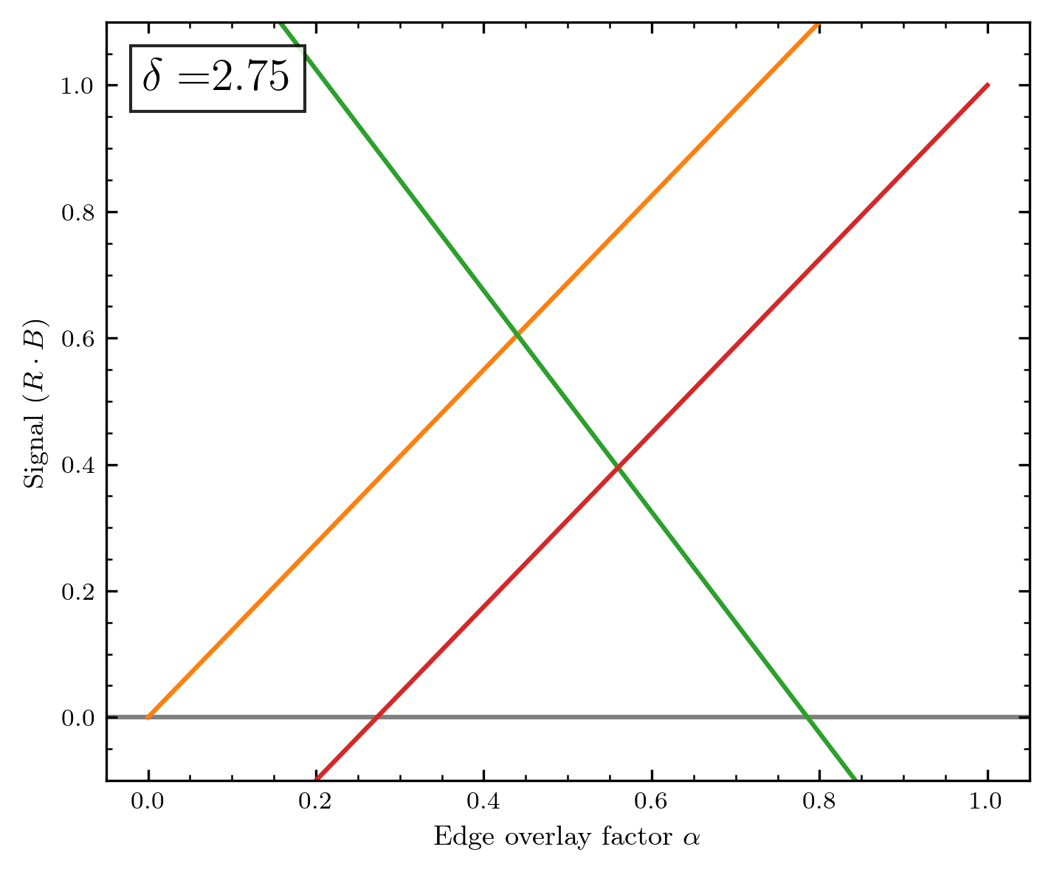

Slide 25
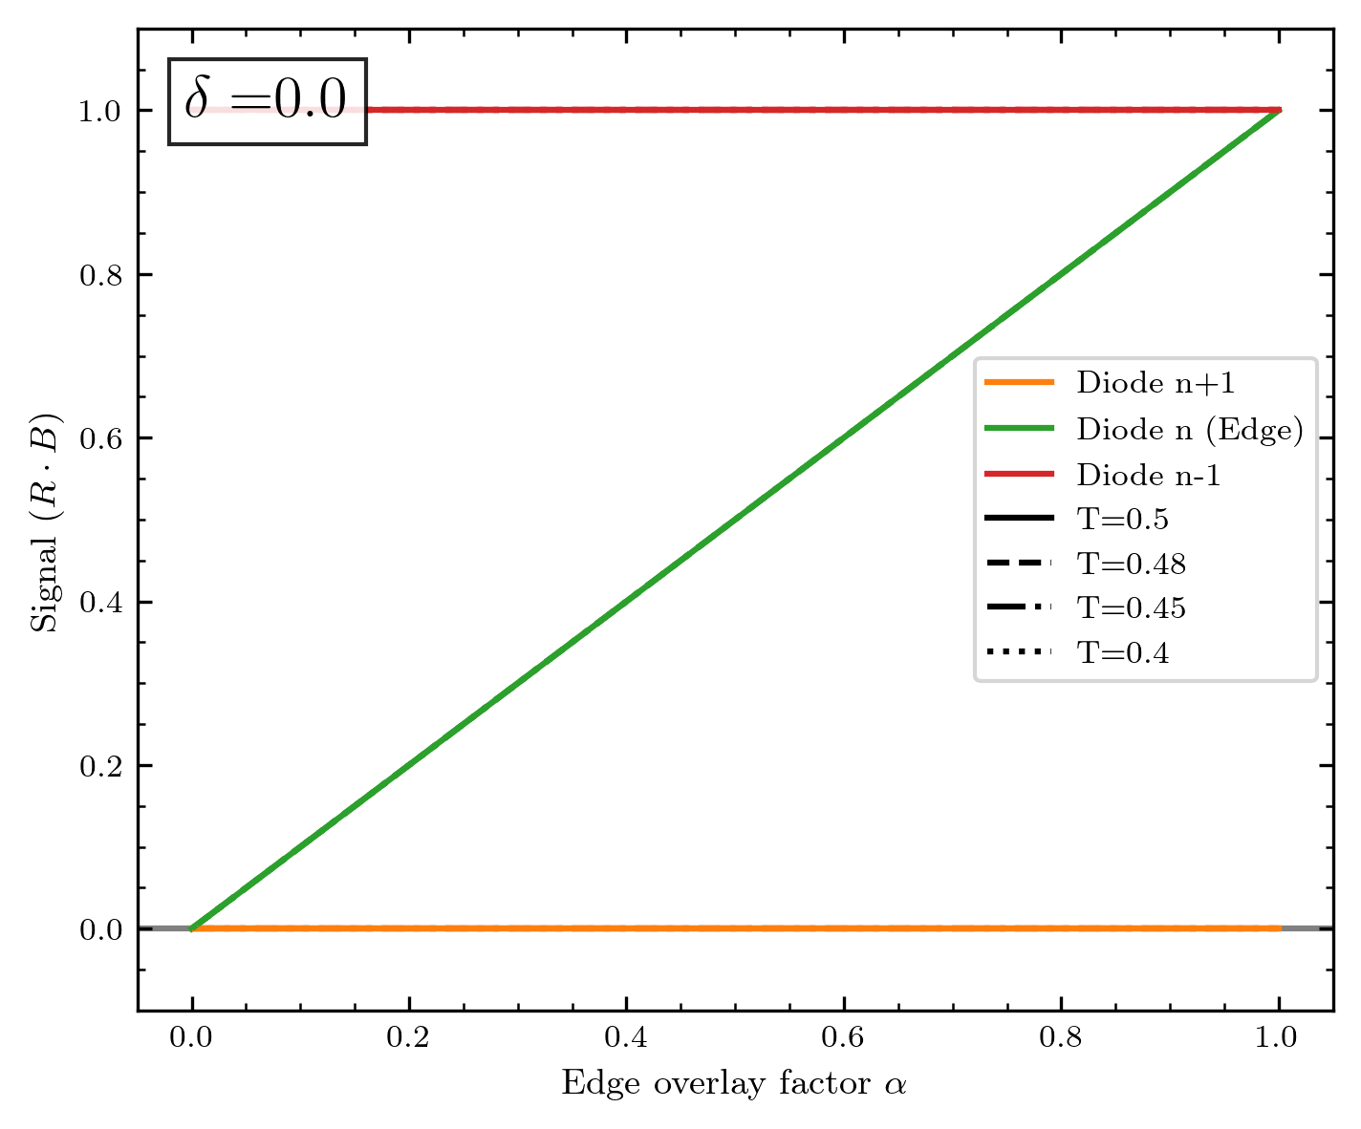
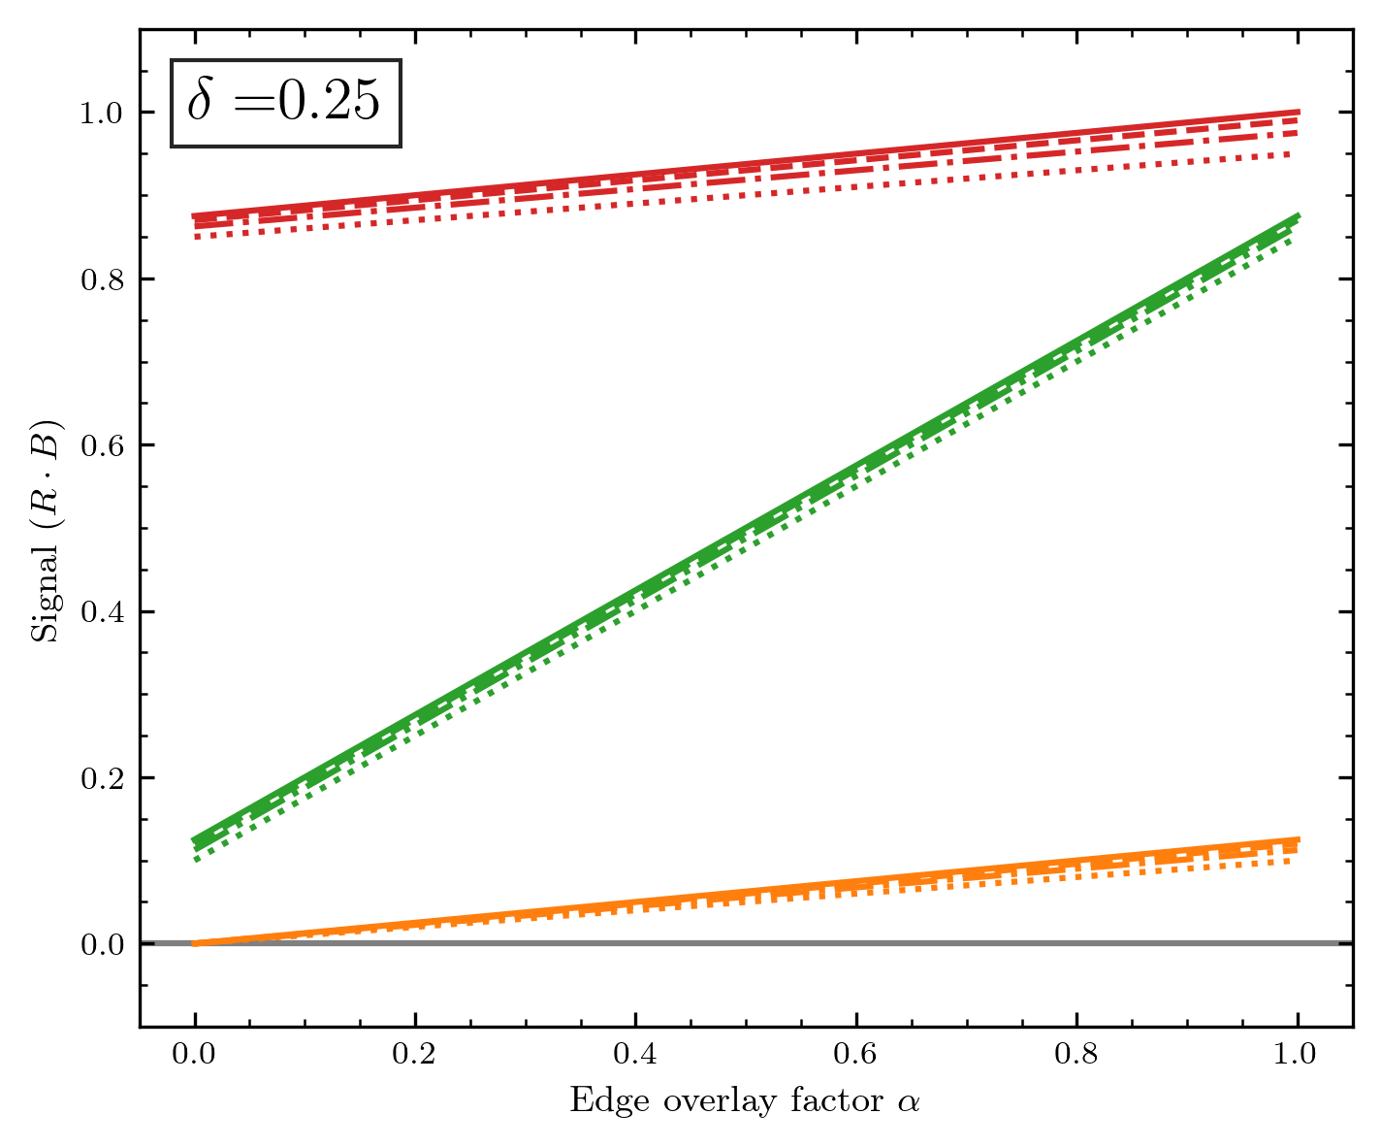
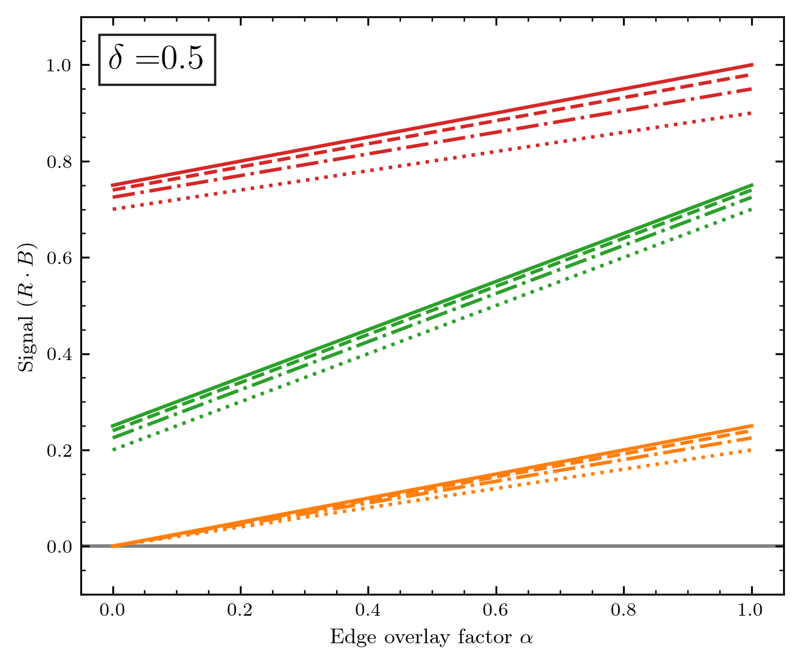
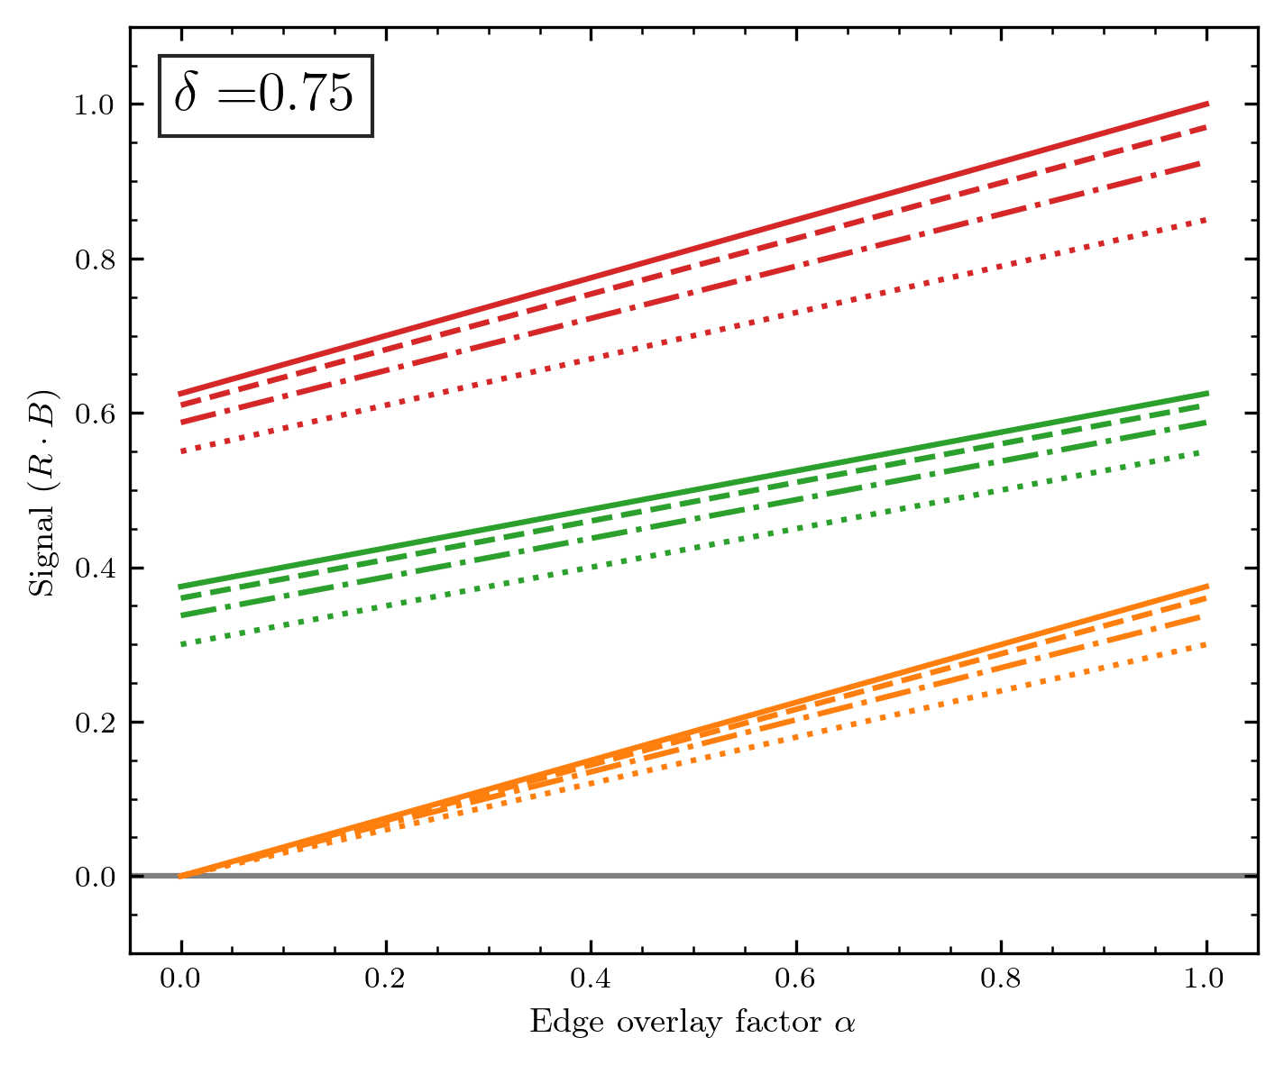
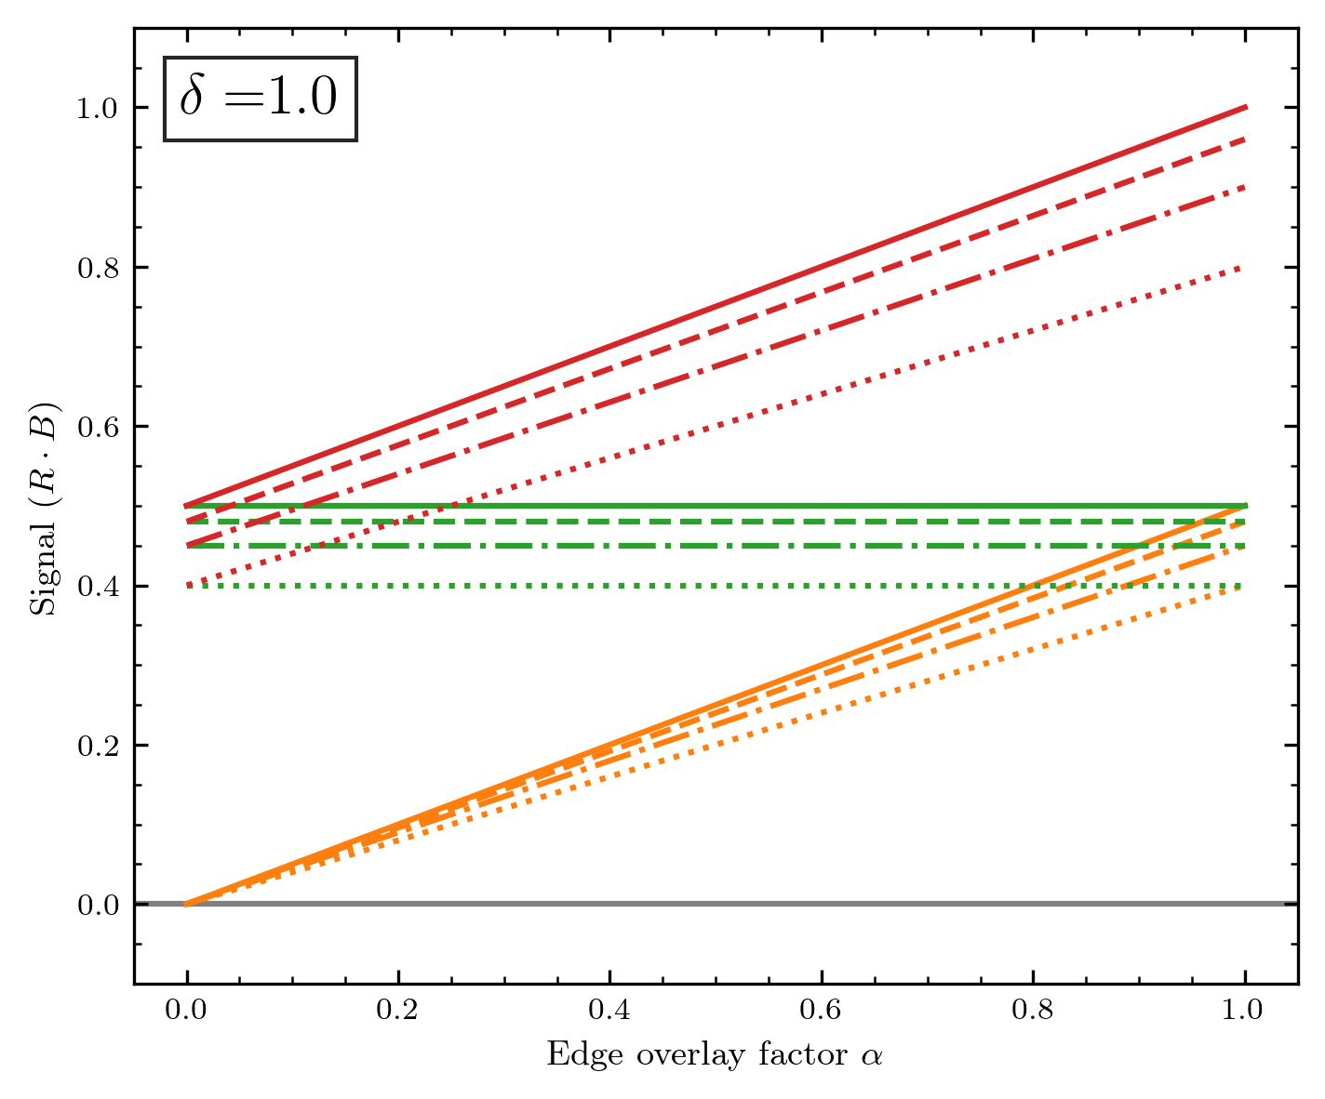
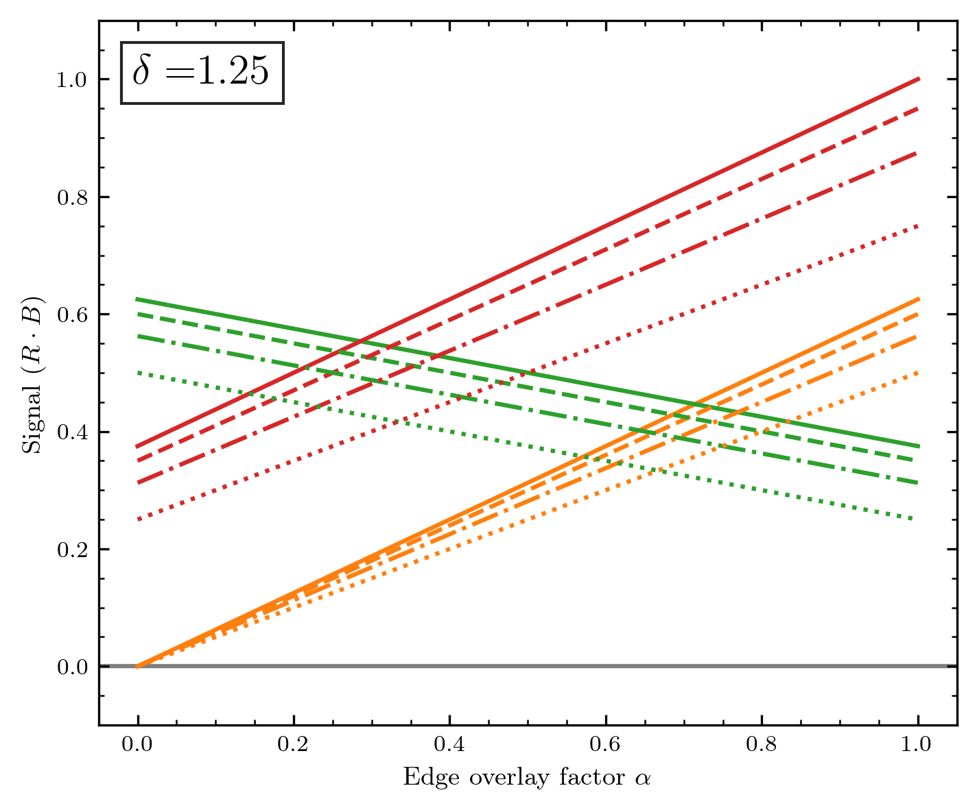

Slide 26
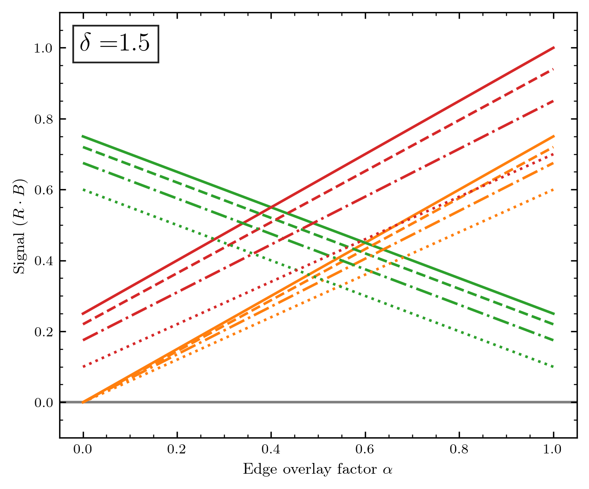
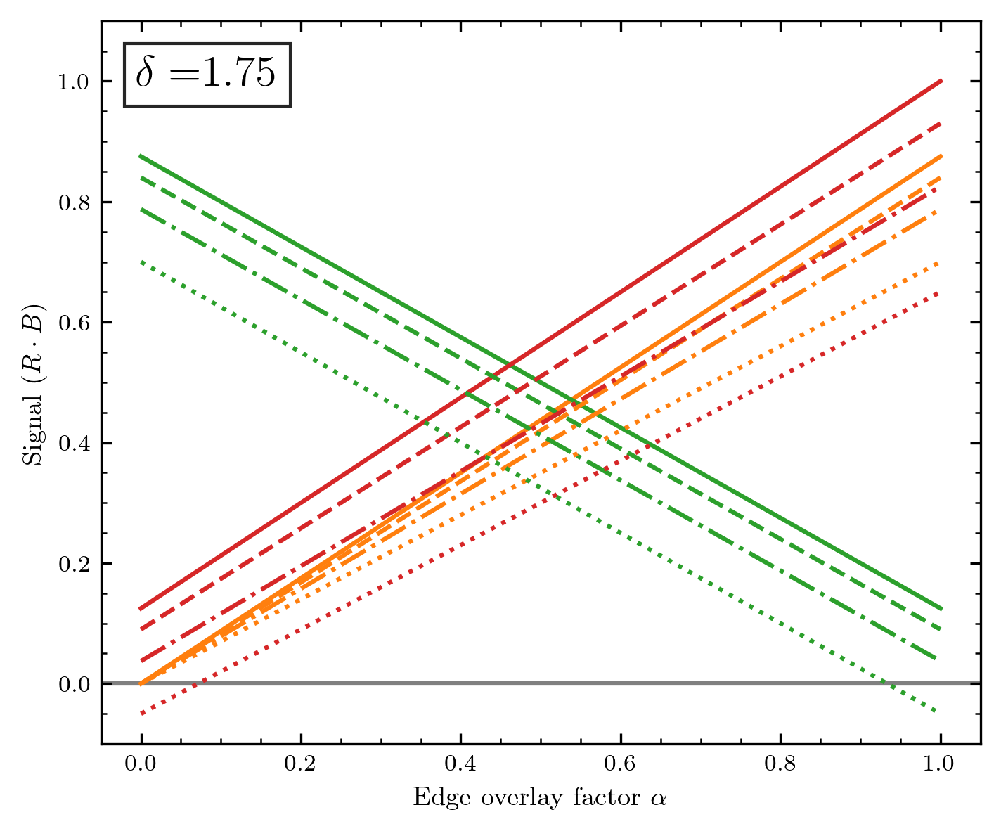
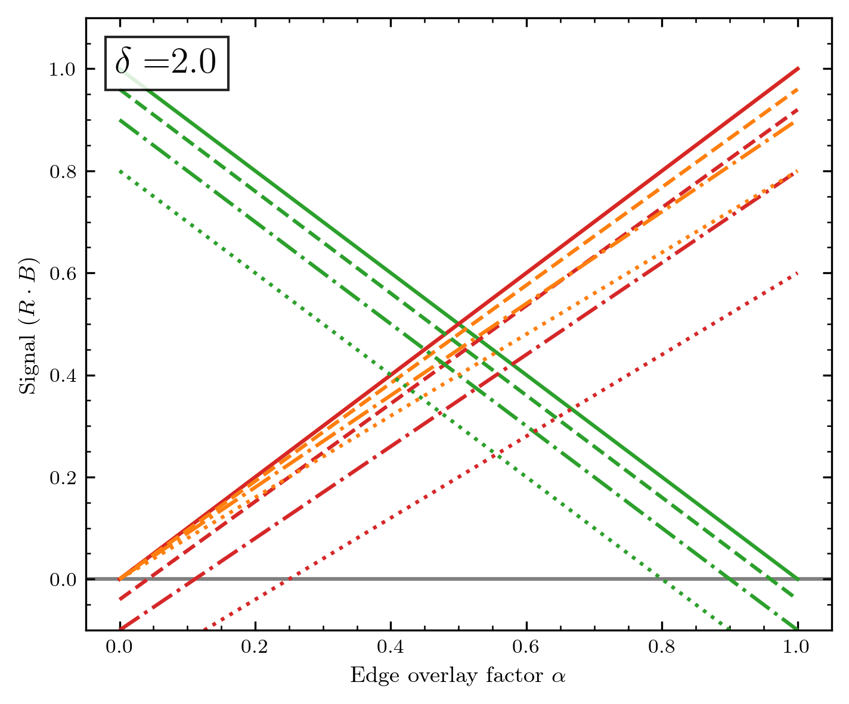
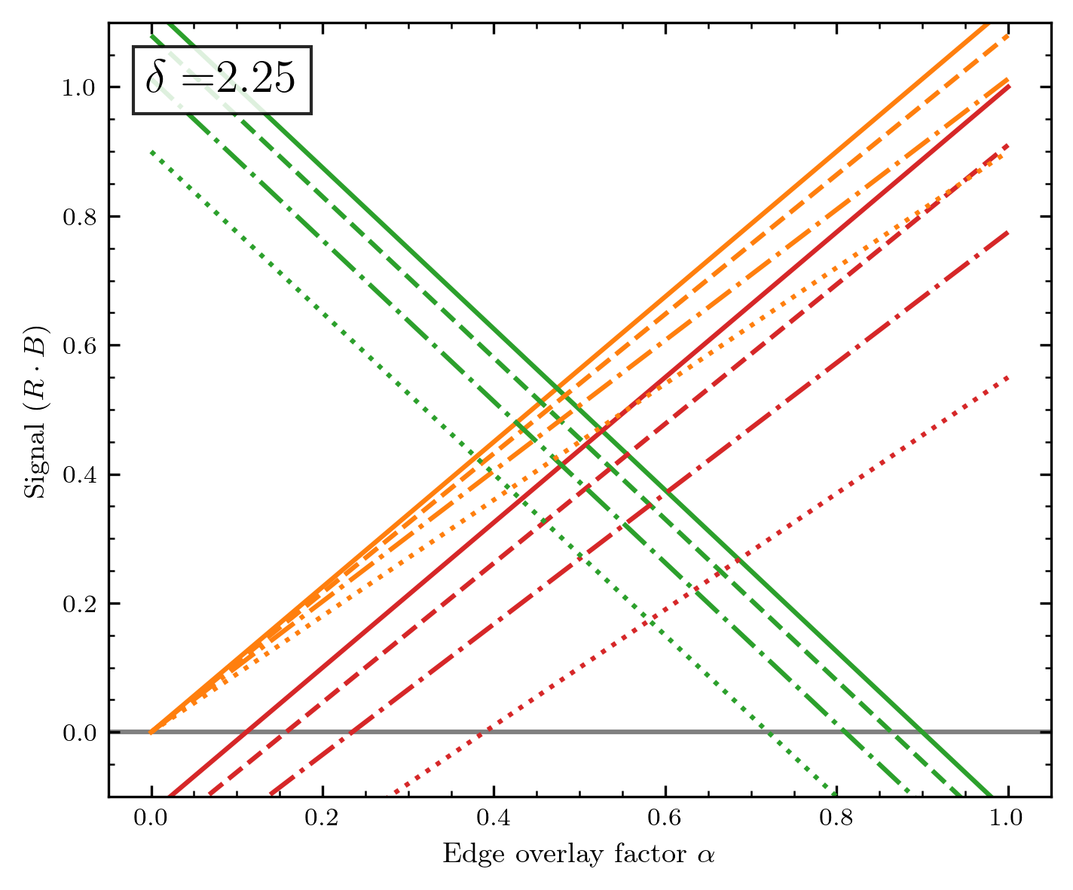
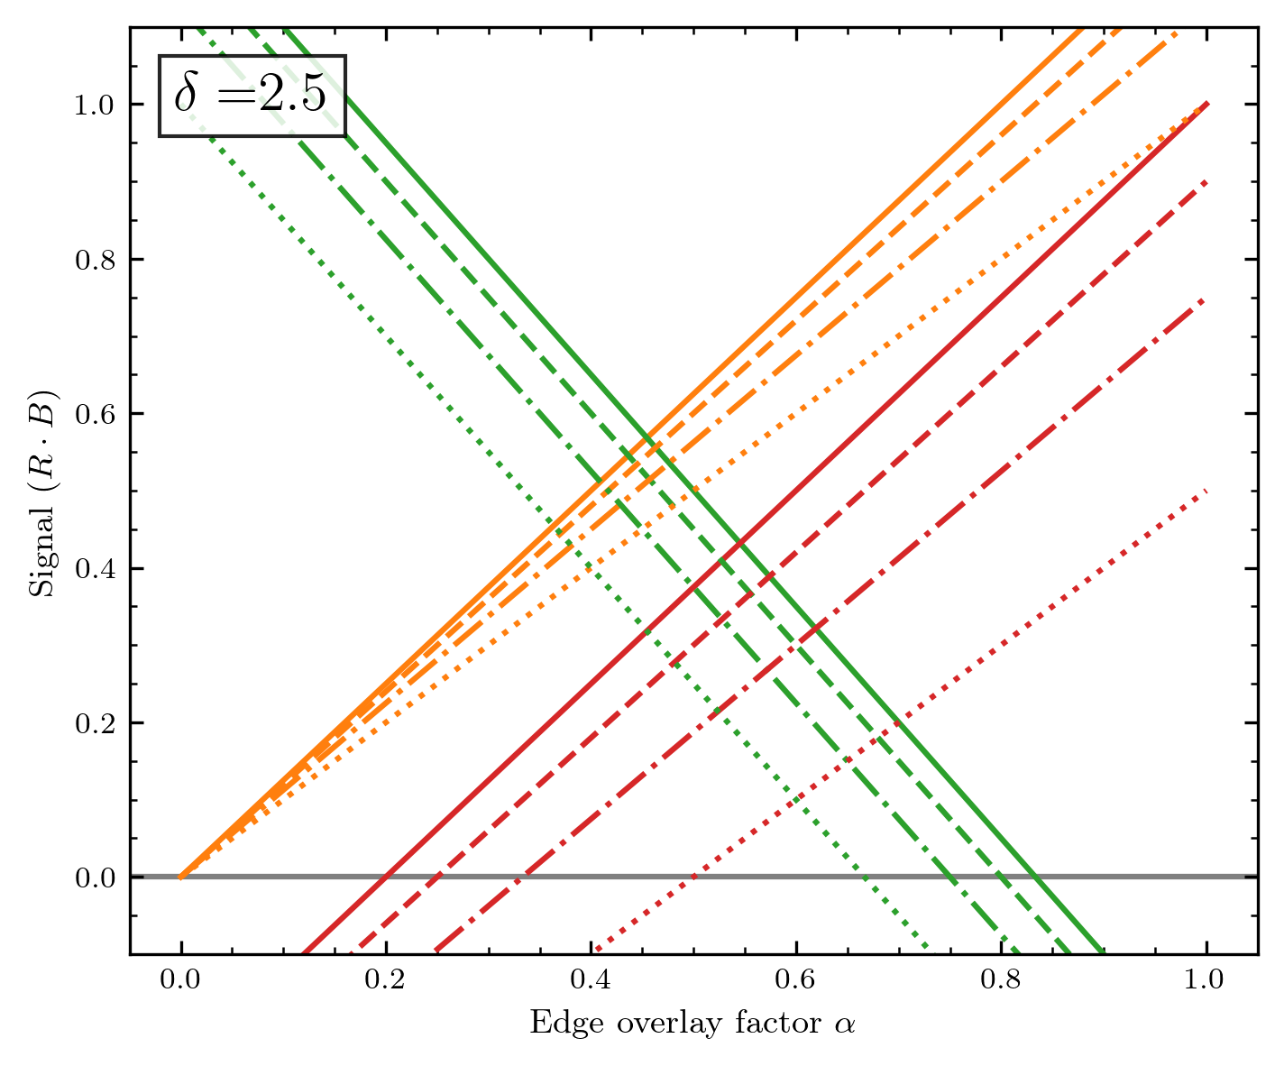
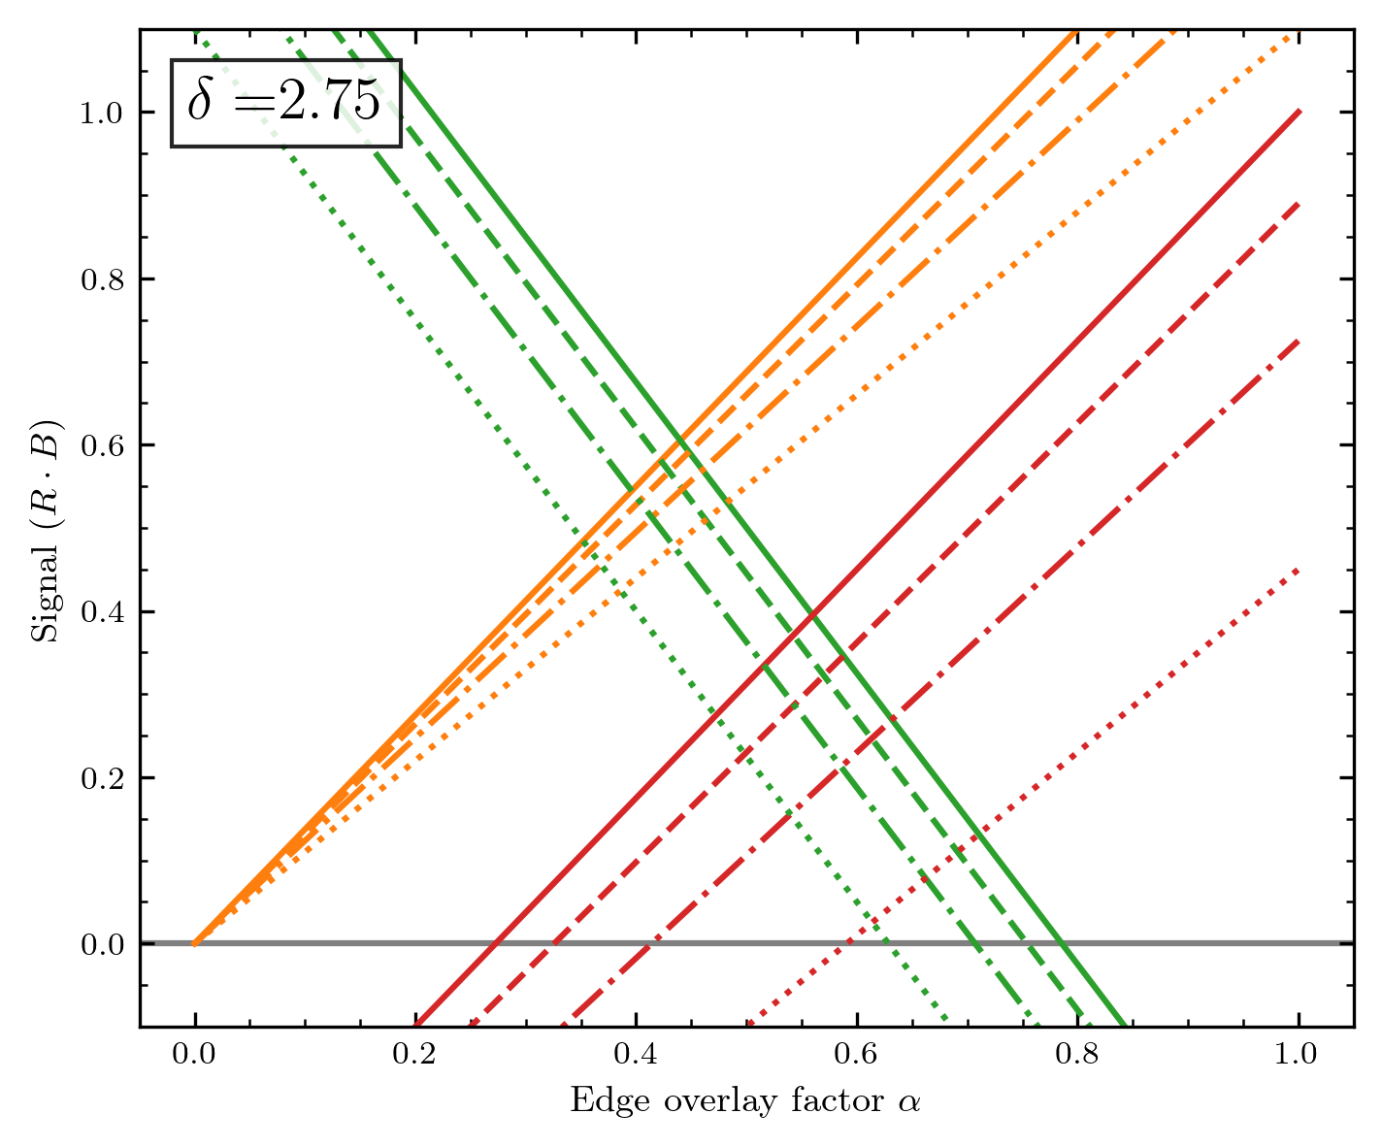

Slide 27
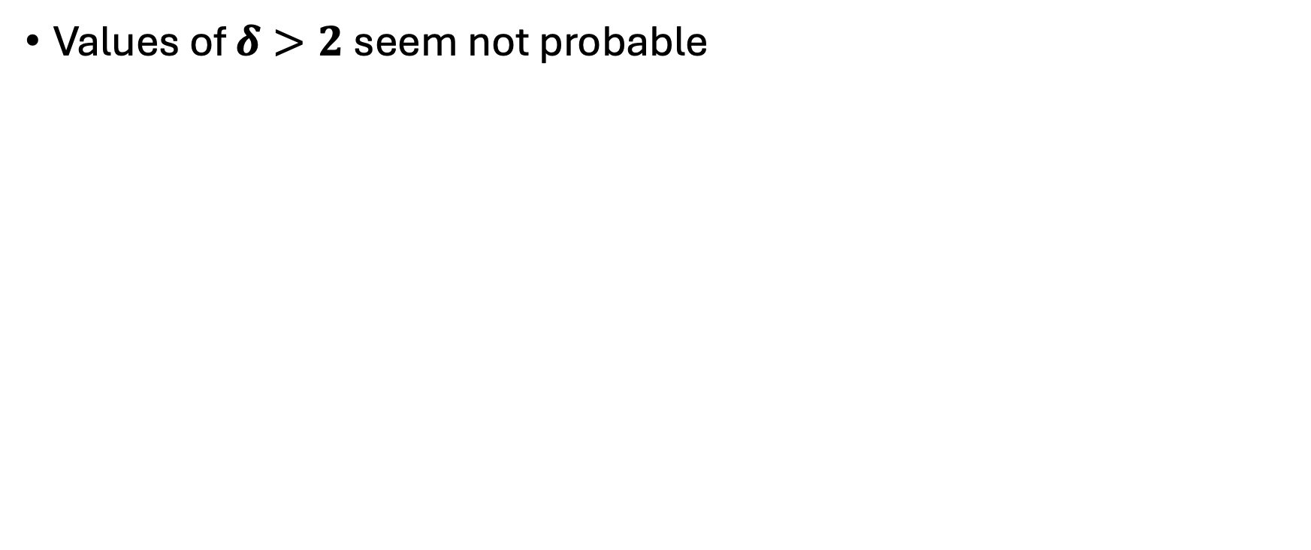
Conclusion
Values of $δ>2$ seem not probable

Slide 28
Designing a correction algorithm
Case: Uniform beam

Slide 29
At first: The correction needs to be applied at each diode array position
This means that for each measurement of the diode array, the correction has to be evaluated – or in other words, we need to localize the edges, which will change for each array position.
I do not want the correction to be fully hand-adjusted, even though total automatisation will also be nearly impossible.
What we at least need: Some info about the shape that was mapped, otherwise the correction makes no sense.
(Imagine a chessboard-like structure mapped with each field having the size of one diode. The algorithm I develop will probably not treat this correct)

Slide 30
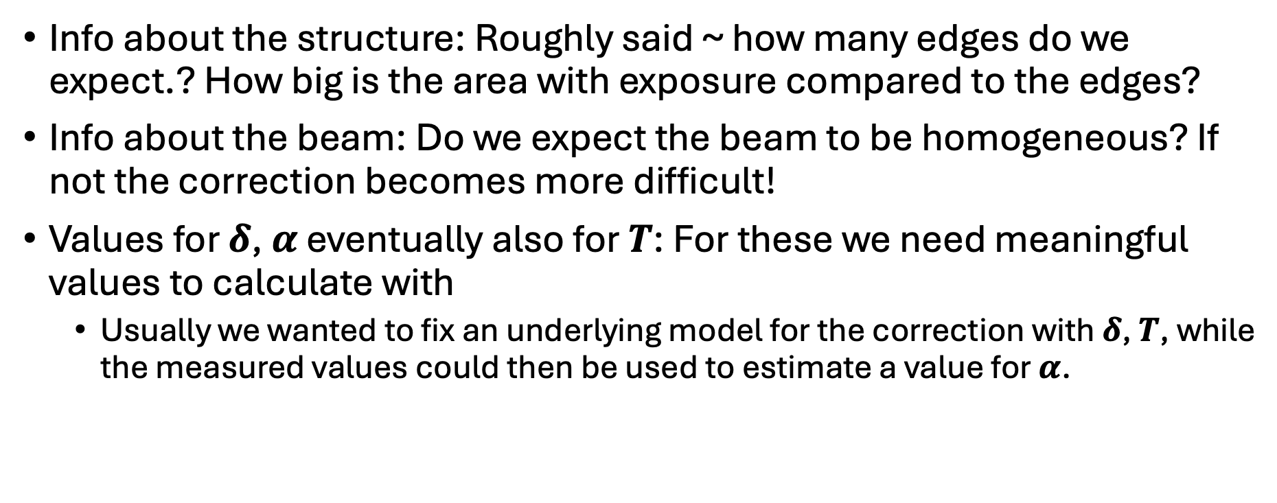
User input for the correction
Info about the structure: Roughly said ~ how many edges do we expect.? How big is the area with exposure compared to the edges?
Info about the beam: Do we expect the beam to be homogeneous? If not the correction becomes more difficult!
Values for $δ$, $α$ eventually also for $T$: For these we need meaningful values to calculate with
Usually we wanted to fix an underlying model for the correction with $δ$, $T$, while the measured values could then be used to estimate a value for $α$.

Slide 31
Rough sketch of the algorithm
Detect edges for the diode array measurement, where a correction needs to be applied.
For all edges: Check if there could be conflict if edges are too close together. (If conflict: …? Maybe more complicated model?)
For all edges without conflict:
Compare the signal of the diodes around the edge
Correct corresponding to model n+1 to 0, n to S(n)+S(n+1) and S(n-1) to full signal
Maybe useful during parameter search: Compare model parameters between each row of map

Slide 32
Detect the edge
For uniform beam: Find a global threshold between signal and no signal
We already used the optimal solution: Otsu‘s method! (Signal and no signal will still be distributed somehow.)
With threshold: Find all changes from no signal to signal (and vice versa)
To verify the edge characteristic check for signature: Signal low to signal high, back to low, then to high (and vice-versa)
If edge is detected do not consider the involved diodes again in the edge search
As shown on the left sketch, one edge pattern will probably trigger three events when using the Otsu‘s threshold.
Problems could occure if the variation is too low (under the threshold) because we e.g. only irradiate a small part of the diode array)
S(n)
n

Slide 33
Edge detection

Slide 34
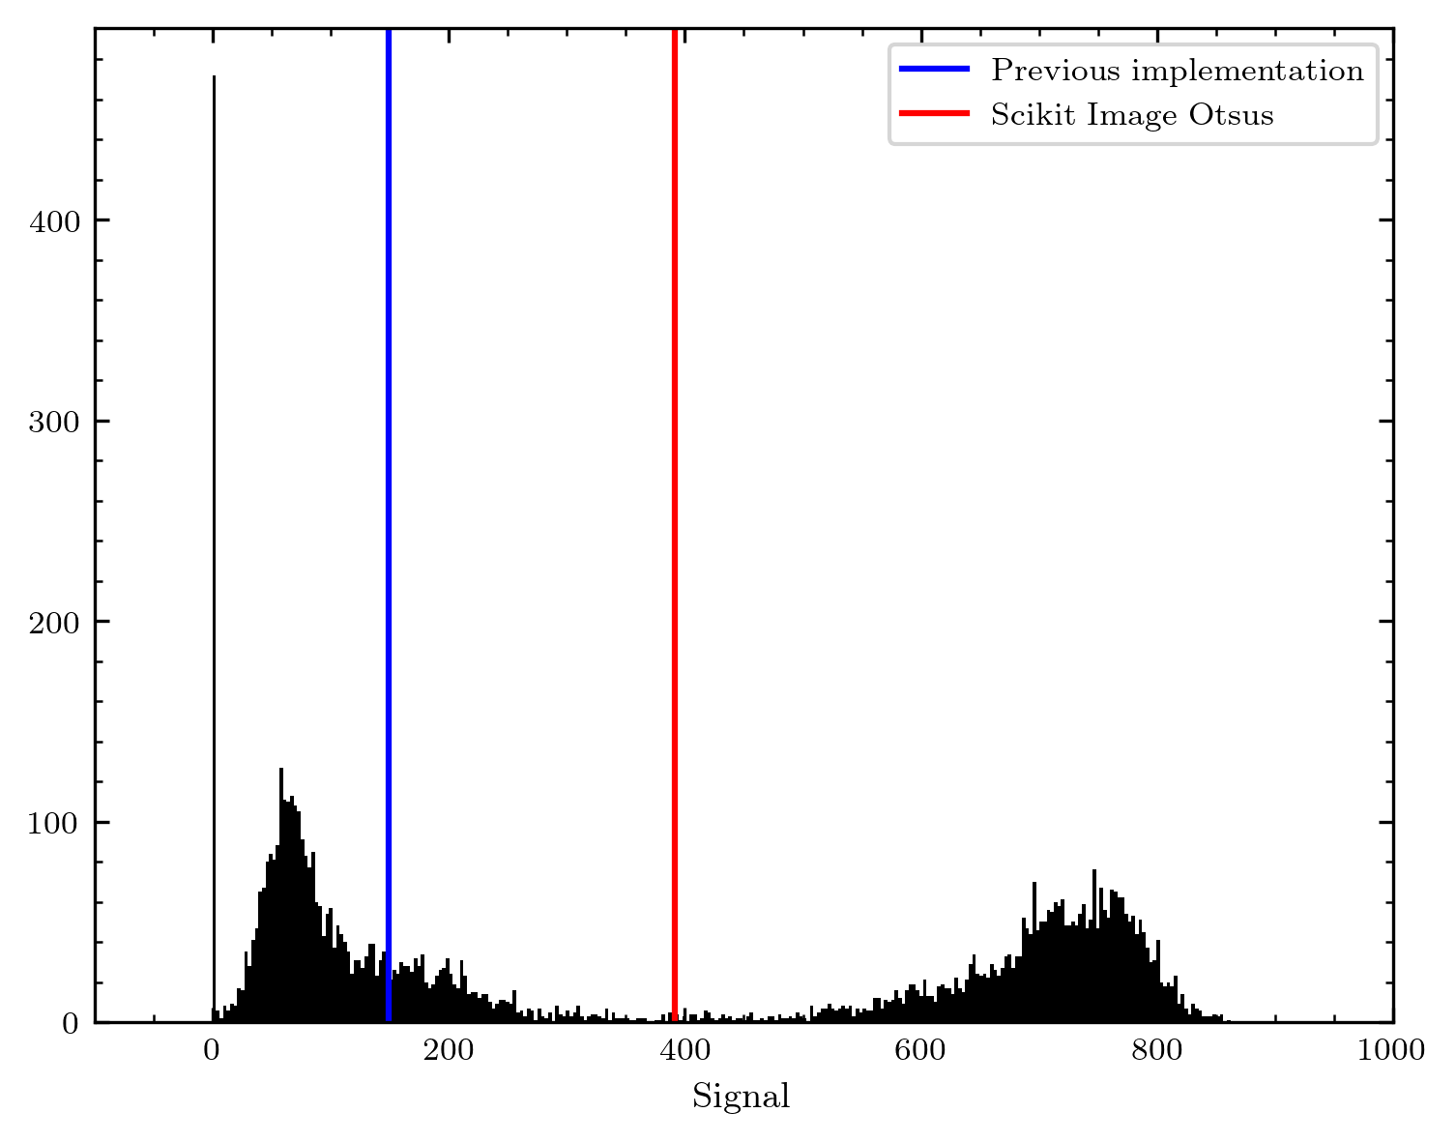
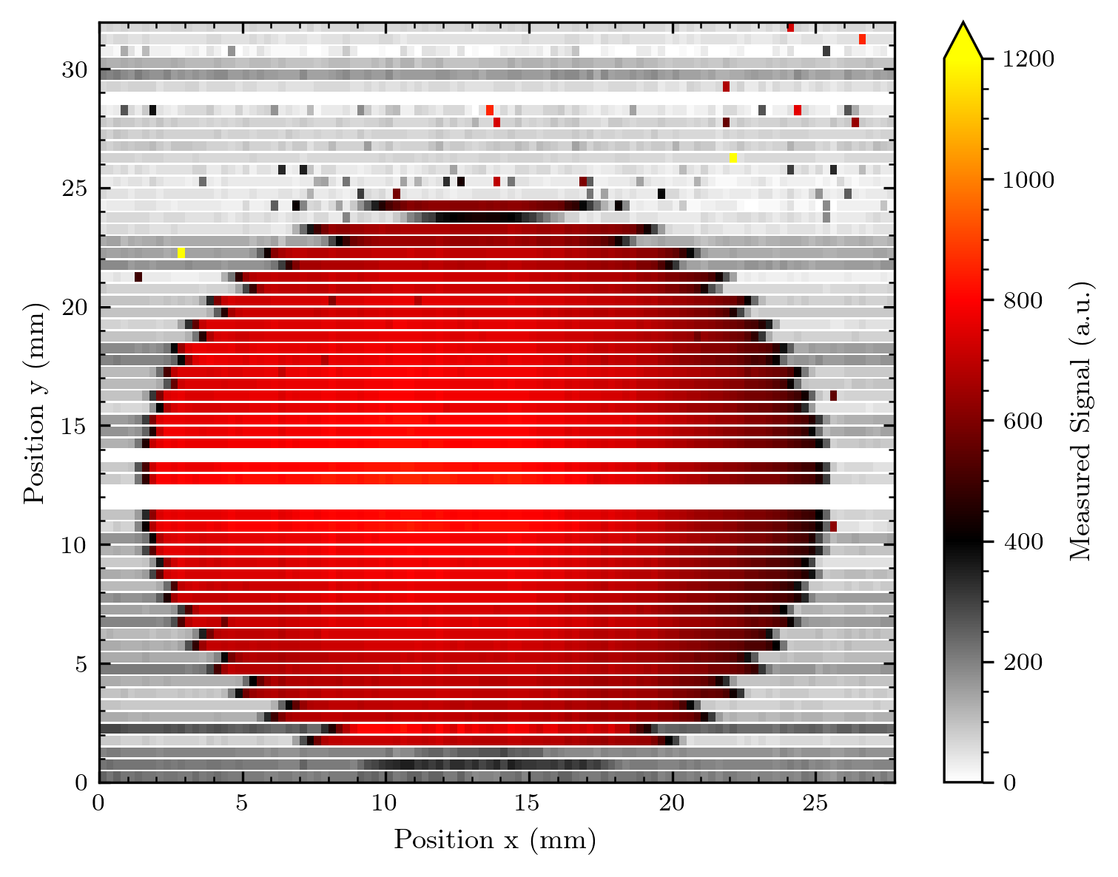
Estimate a threshold
As expected, Otsu‘s method is a good way to estimate a threshold between signal and no signal. The two blocks are distinct distributions, with more than enough space inbetween too determine and work with a threshold.
During the tests, I observed that the previous implementation of Otsu‘s method is not working as expected.
Therefore I will switch to the implementation from scikit-image, which is working without any problems.
from skimage.filters import threshold_otsu
threshold = threshold_otsu(A.map['z‘])
As histogram of signal

Slide 35

Detecting the edges
With the threshold from the Otsu‘s method I simply check where we pass the threshold when passing on two pixels.
From viewing the image with marked positions, the following occurs:
it will be possible to detect edges with the signature I discussed two slides earlier (signal up, signal down, signal up or vice versa)
lines with zero signal can be a problem (not here because two signal lines are inbetween) but I will exclude them for the consideration)
artefacts in the upper image part are not a problem, except when they follow on the last signal column of the imaged object (but I do not see a viable way to filter for artefacts on the edge of the object…)

Slide 36


Detecting the edges 2
Now marked are the signatures explained above. With the signatures following the no signal – signal criteria from Otsu‘s threshold, we can say following:
The outer edges of the circle with the shape defining character are recognized!
Whenever the protoemission effect is so small that the induced signal is below threshold or the pixel with signal loss is above threshold, the signature is per definition not recognizing these cases
One could argue that this might be good, because in these cases the edge shadowing $α$ will be very small, which leads to a different treatment if we do not automatically calculate $α$
Artefacts around the edges lead to wrong signatures – I will thus introduce a simple filter for artefacts

Slide 37
Interlude: A simple artefact filter
Problematic are artefact pixels above the threshold. In the upper part of the image quite some of these pixels appear. (Artefacts in current readout? Not clear where they come from, but they are clearly not linked to the imaged object)
One (safe) way to filter for these single pixels and thus not change the imaged object (if it is sufficiently big):
If neighbours of pixel (only direct neighbours in each column or row) are below threshold and pixel itself is above threshold -> Pixel = Artefact
This will deal with most of the problematic artefacts, except for the ones close directly on the edge. But here, it is unclear if we observe an artefact or the imaged shape. So filtering more, requires more user input information about the imaged shape…

Slide 38

Detecting the edges after filtering
We avoid some signature calls introduced by artefacts! So I will test this detection algorithm for some other images.

Slide 39
Results Edge detection v1
To show what works with this simple edge detection and where the limits are

Slide 40

Some screw images
The correction will still correct for the shape of the round aperture – and also correct the shape of the screw, where the protoemission effect is appearing the strongest.

Slide 41

Also good, the thread of the screw in vertical direction will be hard to correct for nevertheless

Slide 42

Very nice, here nearly all the parts of the thread are recognized.
By the way: With the protoemission effect in mind, this image with the resolution of the screw thread is even more remarkable.

Slide 43


Our logo
without simple filter
with simple filter
This is already a hard test for automatic recognition – and it works pretty well for the distinct edges of the letters.
Here the limit of the simple artefact filter is reached, e.g. the letter “I“ is too small to resolve. For the latest measurements the
artefact filter might not be necessary; we had these single-pixel artefacts mostly during the first measurement set…

Slide 44

The misc shape
Several limits are reached here:
Very small image parts
thus no filtering, but ok
small also in array direction – makes signature call hard
Weak edge overlay – upper part of square is not recognized, while lower is
Also connected: We exceed the clear distinction between signal on – signal off
The round shape features protons in the Bragg peak

Slide 45

When the Otsu‘s thresholding is not working
Here, the middle region with protons in the Bragg regime disturbs the threshold recognition.
Thus the edge regions, where we could still easily correct the round aperture shape is not recognized.
At this moment, we need user input about the imaged object.
Here e.g. only looking at the border regions to correct by filtering the middle could be feasible

Slide 46

When the Otsu‘s thresholding is not working
Here, the middle region with protons in the Bragg regime disturbs the threshold recognition.
Thus the edge regions, where we could still easily correct the round aperture shape is not recognized.
At this moment, we need user input about the imaged object.
Here e.g. only looking at the border regions to correct by filtering the middle could be feasible
The lower signal part from the edge of the aperture is cut off by Otsu‘s method

Slide 47
Conclusion
The simple edge recognition works pretty good for objects resolved in multiple pixels with a clear signal on/off distinction.
One limit: Small edge covering (Harder to distinct from signal modulation or noise)
Small objects need more fine-tuning (compare logo / misc shape)
If we exceed the clear signal on/off distinction, Otsu‘s method for finding a threshold stops working.
Note: From the model discussed so far it is not clear how to correct in the case of a modulated signal (like in a Bragg slope).
I will start with an image correction based on this edge recognition – then I might fine-tune the edge recognition a bit.

Slide 48
Correcting the protoemission in the images

Slide 49

1st the simplest case (Correction v1)
Edge covering of diode n is 1; $T=\frac{1}{2}:$
$$S\left(n+1\right)=\frac{1}{2}δ$$
$$S\left(n\right)=1−\frac{1}{2}δ$$
$$S\left(n−1\right)=1$$
To correct I need to find a value of $δ$ - I will try to calculate it from the data.
If I assume $α=1$; I can track the value of diode n-1 and compare it to the values of diode n and n-1. This gives a clear value for $δ$ and a clear correction (if the edge is sufficiently covered).
Even without calculating $δ$the correction is simply ($δ=2S(n+1)/S(n−1)$):
$S^{′}\left(n+1\right)=0$ (I will set this to the mean of the no signal background)
$S′\left(n\right)=S\left(n+1\right)+S(n)$
$$S′\left(n−1\right)=S\left(n−1\right)$$

Slide 50

Results – Edge recognition v1 and correction v1
The shape is already corrected really well, the signal values seem to be a bit off (assuming the edge is totally covered by diode n is of course not viable)

Slide 51


Results – Edge recognition v1 and correction v1
The interpolated image is already getting close to a round shape. The edge looks a bit patched due to the signal values off + the unrecognised cases with bare edge shadowing.

Slide 52


Results – Edge recognition v1 and correction v1

Slide 53


Results – Edge recognition v1 and correction v1

Slide 54


Results – Edge recognition v1 and correction v1
Here the edge recognition is mainly the problem – e.g. the upper bar of the “T“ is not recognised

Slide 55


Results – Edge recognition v1 and correction v1
As earlier mentioned, here the automatic thresholding becomes a problem too (because of the proton energy shift at the round shape)

Slide 56





Added complexity of edge covering $α$
$$S\left(n+1\right)=\frac{1}{2}αδ$$
$$S\left(n\right)=α+\left(\frac{1}{2}−α \right)δ$$
$$S\left(n−1\right)=1+\frac{1}{2}(α−1)×δ$$
$$S\left(n−2\right)=1$$
If I get the norming 1 from the signal of e.g. diode S(n-2) or some other neighbours apart from the edge, it is possible to
solve these equations for $α, δ$and thus to correct all values for an adaptive edge covering !
$$S′\left(n+1\right)=0$$
$$S′(n)=S\left(n\right)−\left(\frac{1}{2}−α \right)δS\left(n−2\right)$$
$$S′(n−1)=S\left(n−1\right)−\frac{1}{2}(α−1)δS(n−2)$$
$$α= \frac{S\left(n\right)+S\left(n−1\right)−S(n−2)}{S(n−2)}$$
$$δ=\frac{2S(n+1)}{αS(n−2)}$$

Slide 58
Limits and problems with model

Slide 59





Some add to complexity
A situation like this is very likely once we face round edges!
It is probably still reasonable to reduce the complexity and assume $β=1$ in such situations, even though the model is not so much more complicted here. But: Detecting such a case will be very difficult
Diode n+1: Exposure $B\left(n+1\right)=0$
Diode n: Exposure $B\left(n\right)=α×B$
Diode n-1: Exposure $B\left(n−1\right)=β×B$
Diode n-2: Exposure $B\left(n−2\right)=B$
For consistency, I will define a name for this situation and other effects in the following.
This situation shall be denoted as “Multi-Edge“

Slide 60

Some possible problems with the model
Look at the irradiated regions where electrons are emitted.
If we now compare the distance electrons have to travel to reach the neighbour diodes, a discrepancy becomes visible.
I will denote this effect as “Induction of asymmetry“ as it lifts the symmetry and the following simplifications for the diode array.
Namely, this could impact the transfer efficiencies in our model, meaning:
$$T\left(n, n+1\right)<T\left(n, n−1\right)$$
Note that the induced asymmtetry is dependent on the amount of overlay between edge diode n and proton beam irradiation.
The less the diode is irradiated, the bigger the difference in distance is, the bigger the induced asymmetry would get.
Thus the rates $T$ would depend to the beam exposure, and problematically on the geometry of beam exposure.
Diode n+1
Diode n
Diode n-1

Slide 61

Induction of asymmetry for uniform beam
For the uniform beam we already introduced a way to handle the partial irradiation of the edge diode n as: $B\left(n\right)=α×B$
To model the induced asymmetry we could just scale the transfer effiencies with this factor $α$. At first I keep this as general as possible:
If diode n is exposed as$B\left(n\right)=α×B$, we can describe the transfer efficiencies as:
$T\left(n, n+1\right)=ζ\left(α\right) T\left(n, n−1\right)$
with $ζ\left(α\right)∈\left[0, 1\right]$ and $T\left(n, n+1\right)+ζ\left(α\right) T\left(n, n−1\right)=1 −Tx$
(I assume without loss of generality $B\left(n+1\right)=0$ and $B\left(n+1\right)=B$)
To simplify it seems reasonable to assume the linear depency:
$$ζ\left(α\right)=ζ×α ≔ζ^{∗}$$
While I assume the assumption $ζ\left(α\right)=α$ as not necessarily viable.
Diode n+1
Diode n
Diode n-1

Slide 62

Induction of asymmetry for uniform beam
In our model this would change the general signal for a diode n to:
$$S\left(n\right)=\left(R−E\right) ×α_{n}×B$$
$$+E×ζ×α_{n+1}×T×α_{n+1}×B$$
$$+E×ζ×α_{n−1}×T×α_{n−1}×B$$
= $[\left(R−E\right) ×α_{n}+ζ×(α_{n+1}^{2}+α_{n−1}^{2})×E× T]×B$
If we assume diode n to be the only edge diode (WLOG: $α_{n}=α$, $α_{n−1}=1,α_{n+1}=0$):
$$S\left(n+1\right)=[ζ×α^{2}×E× T]×B$$
$$S\left(n\right)=[\left(R−E\right) ×α+ζ×E× T]×B$$
$$S\left(n−1\right)=[\left(R−E\right)+ζ×(1+α^{2})×E× T]×B$$

Slide 63



Induction of asymmetry for uniform beam
I formulate the three equations similar to above for evaluating how the ratio $\frac{E}{R}≔δ$ impacts the effects
$$S\left(n+1\right)=ζ{Tα}^{2}δ$$
$$S\left(n\right)=α+(ζ T−α)δ$$
$$S\left(n−1\right)=1+[ζT\left(1+α^{2}\right)−1]δ$$
This induced asymmetry induces mainly a dependency on $α^{2}$ meaning it would dampen the impact for smaller overlays with the irradiation edge.

